Slide 1
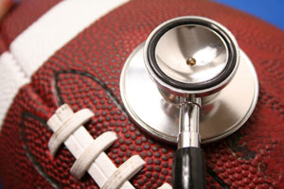
Brief History of Sports Medicine

Slide 2
The First Signs of Sports Medicine
Sports Med first used in ancient Rome and Greece
Athletes were not training properly
“Supervisors” were assigned to educate and monitor these athletes
Soon, strategies to heal and prevent injuries were being used

Slide 3
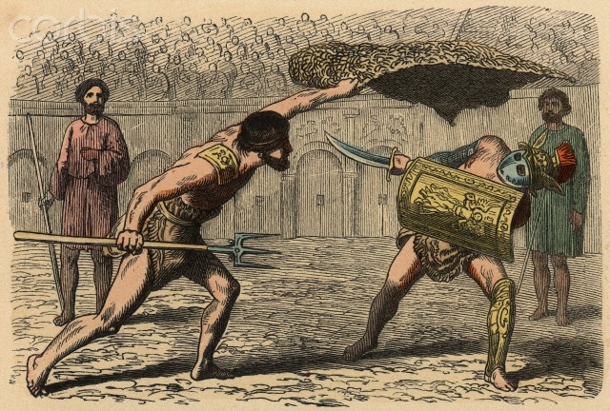
Sports Medicine in History
Training to discourage injuries can be traced back to as early as the 2nd century
Herodicus used therapeutic exercises to help heal injuries
Galen = doctor assigned to monitor Gladiators

Slide 4
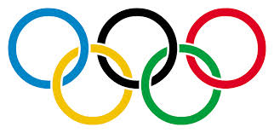
Sports Medicine in History
1928 Olympics
International Congress of Sports Medicine was created
Goal = get real doctors to help prevent athlete injuries
1968 Olympics
Canada = first country with a team of doctors traveling with them
1972 Olympics
First medical team officially associated with Olympics to oversee all athletes

Slide 5
Sports Medicine in History
American College of Sports Medicine (ACSM)
Founded in 1954
Athletes require broadly trained physician when first dealing with injury
“Sports medicine specialists”

Slide 6
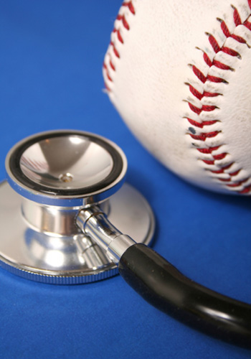
Sports Medicine Today
Now, athletes visit Sports Medicine professionals for multiple reasons
Prevent injuries
Treat injuries
Monitor vitals
Monitor hormone/vitamin levels
Physical fitness tests
Tests/scans
Check ups

Slide 7
Video
http://www.youtube.com/watch?v=JU3TtYNIsns

