Slide 1
INFLAMMATION & HEALING PROCESS
Local Inflammatory Response
In an acute injury, tissue is torn, capillaries are damaged and cells die because of the inference in the blood and oxygen supply. In response, the body reacts by sending specialized cells to the injury in an attempt to limit damage and begin the healing process.

Slide 2
SIGNS & SYMPTOMS OF INFLAMMATION
PAIN: CAUSED BY AN INCREASE PRESSURE ON NERVE ENDINGS FROM INTERNAL HEMORRHAGE AD FROM CELLULAR RESPONSE TO THE LACK OF OXYGEN
SWELLING (AKA EDEMA): IS CAUSED BY THE ACCUMULATION OF FLUIDS IN THE DAMAGED AREA
REDNESS/WARM FEELING: DUE TO AN INCREASED BLOOD SUPPLY AS THE BODY ATTEMPTS TO PROVIDE THE INJURY SITE WITH NUTRIENTS FOR REPAIR
LOSS OF FUNCTION OR MOTION

Slide 3
IMMEDIATE CARE
The goal is to keep the local inflammatory response at a minimal. This is done by providing immediate care to the injury.
Rest: Protects from further trauma, splint/wrap the injured area, provide crutches if necessary.
Ice: Vasoconstriction (decreases hemorrhage), Decrease pain (within 60 sec’s of applying ice, we see a decrease in pain receptor), Decrease spasm (causes muscle spindle to relax)
Compression: Controls Edema (aka swelling), helps control hemorrhage and encourages clotting. Compression should be maintained continuously for 72 hours
Elevation: Helps control edema by using gravity and assists the lymphatic system in removing fluid build up

Slide 4
LOCAL INFLAMMATORY RESPONSE CYCLE
Local Inflammatory Response is proportional to the amount of dead and dying cells. The fewer cells which die, the less inflammation occurs, and the quicker the injury heals.
Trauma ~ (Necrosis)
Dead & Dying Cells
Ischemia
Release of toxins:
~ necrosin
~histamine
~heparin
Edema, Hemorrhage, Pain
Spasm

Slide 5
RELEASE OF TOXINS
Histamine: Causes vasodilation which increases local blood flow.
Heparin: Deters blood clotting.
Necrosin: Irritant…but in the long run it is helpful because it draws WBC’s to the area

Slide 6
THE HEALING PROCESS
ALL FLUIDS AND DEAD CELLS THAT HAVE RESULTED IN SWELLING MUST BE REMOVED FROM THE INJURY SITE BY THE CIRCULATORY AND THE LYMPHATIC SYSTEMS BEFORE OXYGEN AND NUTRIENT SUPPLYING CAPILLARIES CAN BE FORMED TO ASSIST REPAIR

Slide 7
Factors That Impede Healing
Extent of injury
Edema
Hemorrhage
Poor vascular supply
Muscle spasm
Atrophy
Infection
Health
Age
Nutrition

Slide 8
Types of Tissue and Their Healing
Ligaments and Tendons
Decent blood supply
Requires a lot of collagen being laid down
Long full healing process (12 months)
Muscle
Initial bleeding followed by laying down a ground substance
Healing may last 6-8 weeks depending on the muscle injured
Cartilage
Little or no direct blood supply
Articular cartilage that fails to clot heals very slowly
Limited capacity to heal

Slide 9
Grades of Sprains/Strains
Grade I
Some pain, minimal loss of function, no abnormal function, mild point tenderness
Grade II
Pain, moderate loss of function, swelling and instability
Grade III
Extremely painful, inevitable loss of function, swelling

Slide 10
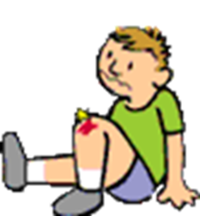
TISSUE HEALING: Phase 1
Acute Inflammatory
During this phase there is increase blood flow to the area that brings cells and chemicals to begin the healing process and “clean up debris”.
Phagocytes- Eat up dead cells.
Leukocytes- Infection fighting white blood cells.
Platelets-Carry blood clotting materials.

Slide 11
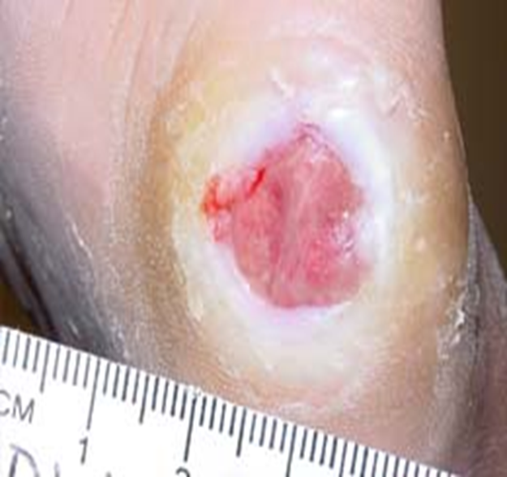
TISSUE HEALING: Phase 2
Fibroblastic/Regeneration Phase –The injured area has been filled with the blood, cells, and chemicals needed to rebuild the injury.
Fibroblasts begin building fibers across the injury and form the scar.

Slide 12
TISSUE HEALING: Phase 3
Remodeling – Continues until the tissue is healed
Builds tissue strength in the tendons, ligaments and muscles to withstand stress applied to the body.

