Slide 1
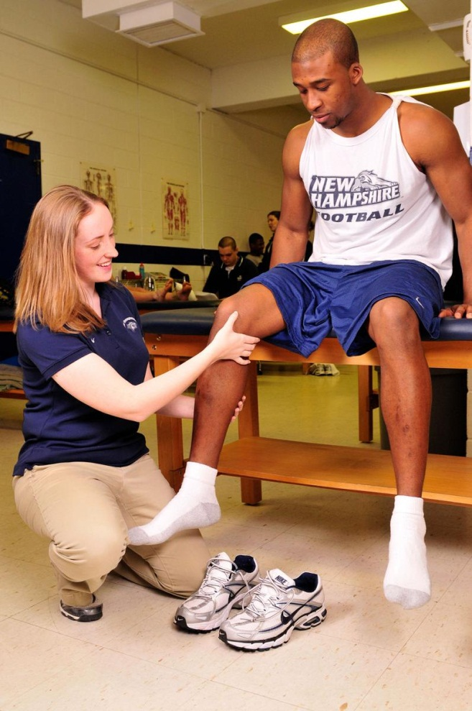
Athletic Training
Ms. Ryder

Slide 2
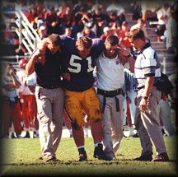
The Sports Medicine Team
The Central Team
The athlete
The athletes parents or guardian
Team physician
The Certified Athletic Trainer
The Coach

Slide 3
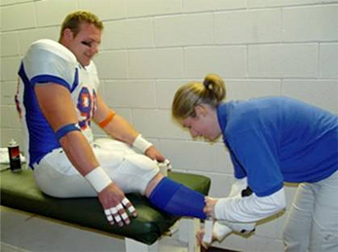
ATC
ATC = Certified Athletic Trainer
Educational Requirements:
Bachelor’s Degree
Certification
Clinical experiences under appropriate supervision

Slide 4
Certification
National Athletic Trainers’ Association Board of Certification, Inc. (NATABOC) examination
Prevention
Recognition, evaluation, and assessment
Immediate care
Treatment, rehabilitation, and reconditioning
Organization and administration
Professional development and responsibility

Slide 5
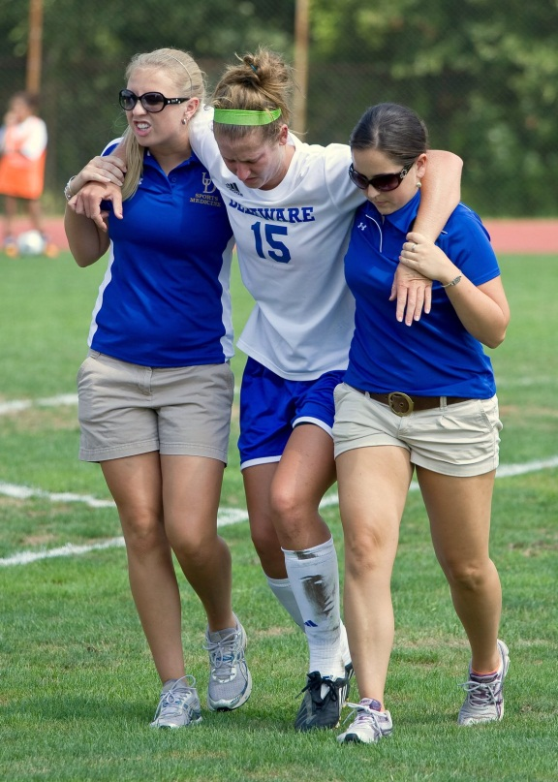
Title IX
Title IX = equal treatment and opportunity to participate in sports for males and females
That means equal:
Staff per athlete
Attention
Facilities
Number of athletes recruited
Money!!!

Slide 6
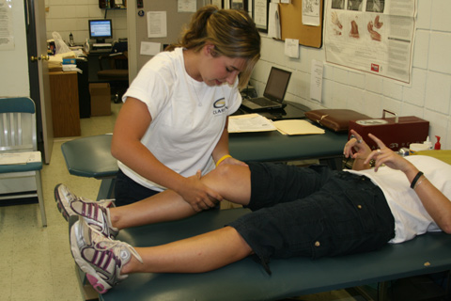
Characteristics of an ATC
In order to be a successful Athletic Trainer, you must possess the following skills:
Knowledge of anatomy, physiology, and first aid
Problem solving
Social
Communication
Motor
Organizational
Diligent note-taking
Calm during emergencies

Slide 7
ATC Daily Tasks
As an Athletic Trainer, you can expect to do the following every day:
Analyze injuries
Tape and bandage
Implement rehab programs
Monitor exercises
Demonstrate movements
Administer therapeutic modalities
Record, organize, and store ALL injury info.

Slide 8
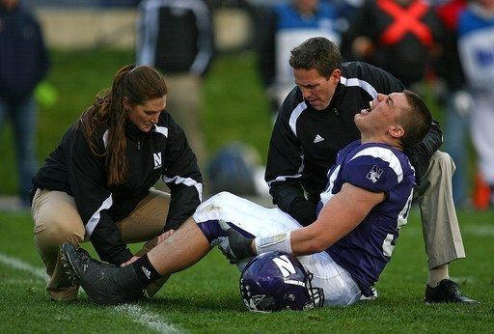
Liability and Risk Management
Liability = who is the responsible party?
As an ATC, you MUST protect yourself from risk of liability issues

Slide 9
Liability and Risk Management
How to minimize your risk as an ATC:
Work within your scope and knowledge
Keep accurate records
Follow training room rules and procedures
Always have supervision
Communicate with coaches, parents, and admin.
Inspect sports facilities and equipment
Establish return-to-play protocol
Consult a physician when needed
Make an emergency action plan

Slide 10
Liability and Risk Management
Hippocratic Oath
A declaration made by Hippocrates (philosopher)
Basically says: “I will always do what is in the best interest of the patient and I will never use my power to do harm”
ALL medical professionals must take the Hippocratic Oath

Slide 11
HIPAA
Health Insurance Portability and Accountability Act (1996)
Keeps your medical records private
No one can share your info without your formal consent
***SPECIFIC EXCEPTIONS***
You can ask for copies of EVERYTHING
Health records can only be used for health reasons

Slide 12
Careers in Athletic Training
Include:
Sports medicine clinics
Public and private high schools
Colleges and universities
Amateur and professional sports teams
Health and fitness centers
Businesses
Olympic teams and training centers
Hospitals and medical clinics

Slide 13
Professional Organizations
National Athletic Trainers’ Association (NATA)
Largest U.S. certifying organization for ATCs
Regional, state, and local trainers’ associations
Promote athletic training, wellness, and safety of athletes at the local level
Example: California Athletic Trainers Association (CATA)
Example: Far West Athletic Trainers Association (FWATA)

Slide 14
Athletic Training
http://www.youtube.com/watch?v=R6NKBdM1hOw
http://www.youtube.com/watch?v=A9U1EVUph3M

