Slide 1
Introduction to Sports Medicine
Ms. Ryder Spring 2018

Slide 2
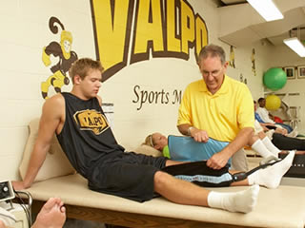
Sports Medicine
Sports Medicine = the branch of health care that deals with illnesses and injuries resulting from participation in sports, athletic activities, or unpredictable accidents
Sports medicine professionals work primarily with athletes
Athletes vary in age, sport, experience, and skill level

Slide 3
Sports Medicine
Disciplines required for sports medicine:
Anatomy
Physiology
Strength Training
Injury prevention, diagnosis, and treatment
Psychology
Nutrition
Knowledge of sports and athletic activity

Slide 4
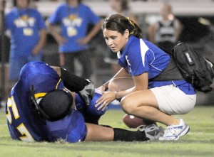
Career Opportunities
Athletic Training
Deals with prevention, diagnosis, and treatment of athletic injuries and the management of training methods
Works with professional or amateur athletes and the general active population

Slide 5
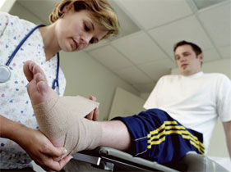
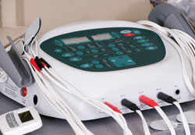
Main Method of Treatment
Taping and Bracing
Supporting the joints to speed the healing process
Compression to help limit/reduce swelling
Therapeutic Modalities
The use of heat, cold, or electrical stimulation to produce an increase or decrease in blood flow

Slide 6
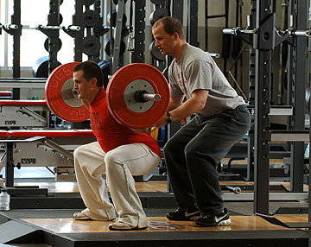
Career Opportunities
Strength and Conditioning Specialist
Evaluates current level of fitness and athleticism
Goal is to help individual/team increase strength and power while promoting a healthy lifestyle

Slide 7
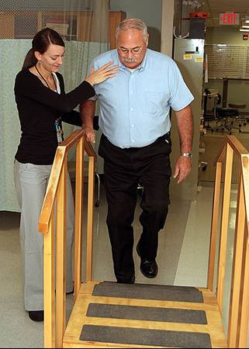
Career Opportunities
Physical Therapist
Help those who are injured to increase movement and decrease pain
Main goal = return patient to physical abilities present before the injury
Deal with people of all ages, including the elderly
Work in a variety of settings
Do NOT deal primarily with athletes

Slide 8
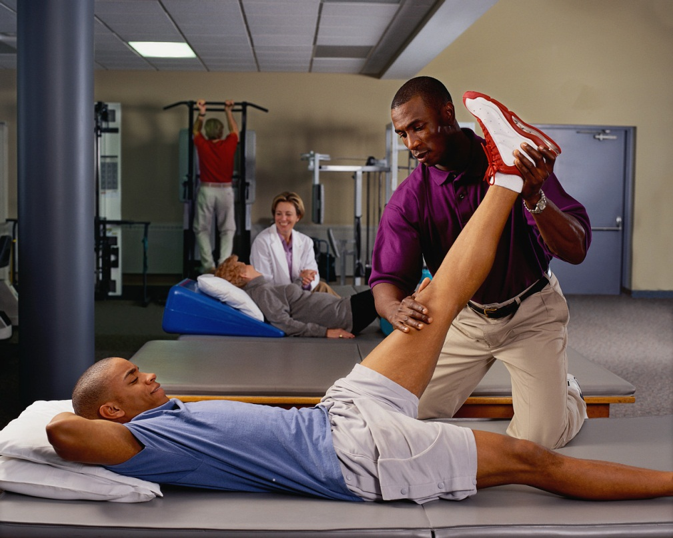
Career Opportunities
Physical Therapy Assistant
2 years associates degree
Involved in clinical tasks such as patient care and recording treatments
Under the supervision of a Physical Therapist

Slide 9
Career Opportunities
Professional Fitness Trainer (aka Personal Trainer)
Works one-on-one with individuals
Assesses client’s current fitness status and develops a fitness plan
Guides client through every step of fitness plan until goals are met
Does NOT only work with athletes

Slide 10
Physical Fitness Program
A customized plan designed to help your client:
Become physically capable of accomplishing a goal
Ex: run a marathon
Adjust body weight
Increase speed, power, strength, endurance, agility, or coordination
Learn how to lead a healthy life and enjoy physical activity
Should not cause any undue physical stress or pain

Slide 11
Career Opportunities
Sports Nutritionist
Specializes in developing proper nutrition plans for athletes to achieve their best results in an athletic event
Works to ensure athlete maintains proper weight, nutrient, and energy levels
Must be aware of substance rules and regulations

Slide 12
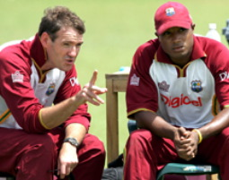
Career Opportunities
Sports Psychologist
Improve athletic performance and increase motivation through psychology
Help the athlete to improve focus and decrease anxiety
Help athletes “get over losses”
Ex: Baseball pitcher

Slide 13
The Olympics and the Importance of Sports Psychology:
http://www.youtube.com/watch?v=d8DSzLpEru0

