Slide 1
Additional Sports Medicine Careers
Ms. Ryder
Spring 2018

Slide 2
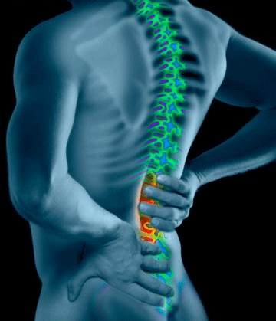
Chiropractor
The diagnosis, treatment and prevention of disorders of the neuromusculoskeletal system and the effects of these disorders on general health
Chiropractors emphasize manual therapy including joint adjustment and manipulation with particular focus on joint dysfunction/subluxations

Slide 3
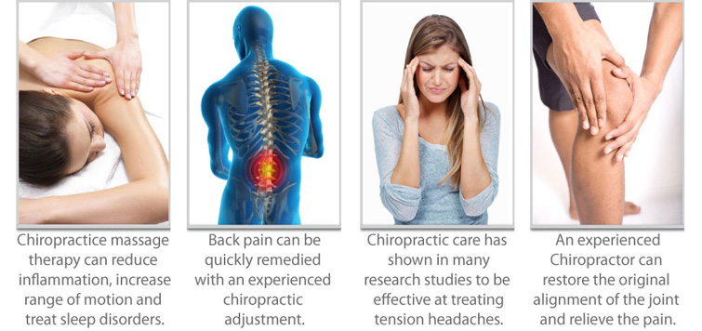
Chiropractor

Slide 4
Chiropractor
http://www.youtube.com/watch?v=WqpSpd2Bs0I
http://www.youtube.com/watch?v=EKAsml2S-AU

Slide 5
Acupuncture
A collection of procedures involving penetration of the skin with needles at very specific points on the body
A component of traditional Chinese medicine (TCM)
According to traditional Chinese medicine, stimulating specific acupuncture points corrects imbalances in the flow of qi through channels known as meridians

Slide 6
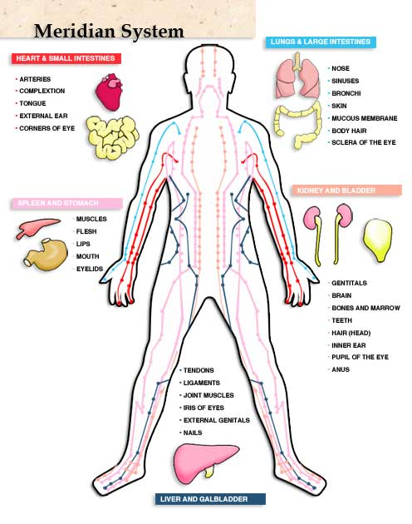
Acupuncture

Slide 7
Acupuncture
http://www.youtube.com/watch?v=SltB04exwo4
http://www.youtube.com/watch?v=paByh9AnEsE

Slide 8
Massage Therapist
Scientific manipulation of the soft tissues for the purpose of normalizing those tissues and minimizing pain
Consists of manual techniques that include applying fixed or movable pressure, holding, and/or causing movement of or to the body
Massage is known to:
Affect circulation of blood and lymph
Reduce muscular tension
Affect the nervous system through stimulation or sedation, and enhance tissue healing

Slide 9
Massage Therapist
http://www.youtube.com/watch?v=qKNlXYCYnyw

Slide 10
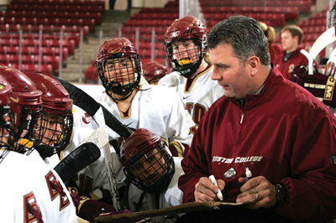
Coach
Teaching, training and supporting an individual toward achieving a specific personal, educational, or athletic goal
Requires a great amount of knowledge and planning

Slide 11
Coach
http://www.youtube.com/watch?v=b0dLpQPVjh8

Slide 12
Teacher
Deliver content to students in a manner that is accessible to all
Measure student learning using formal and informal assessments
Create lesson plans, assessments, activities, and projects
Remain knowledgeable and up-to-date in subject area

Slide 13
Teacher
http://www.youtube.com/watch?v=7bIQ4-3XSxU
Student speech:
http://www.youtube.com/watch?v=GjwjZe8u0-E

Slide 14
Researcher
Focus on injuries, equipment, and supplements and their effects on sports performance
Develop strategies to help protect, heal, and improve athletes

Slide 15
Sports Research
http://www.youtube.com/watch?v=3MrlfEQ1zdE

