Slide 1
Knee Pathologies
The knee is the largest joint in the body, and one of the most prone to injury

Slide 2
Patellofemoral Problems
Articulation of the patella with the femur
Chondromalacia “Runner’s Knee”
Cartilage on the posterior side of the patella deteriorates
S & Sx: aching pain in the front or behind the knee cap, knee is giving way, crepitus, patellofemoral joint pain, and mild swelling
Tx: RICE, NSAIDs, stretching.shoe inserts, taping and bracing

Slide 3
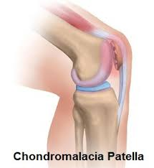

Slide 4
Patellar Tendonitis
Inflammation of the patellar tendon
Caused by high-force, repetitive strain.
S & Sx: Anterior knee pain and local tenderness over insertion
Tx: RICE, NSAIDs, ultrasound, stretching, bracing, and taping

Slide 5
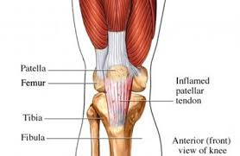

Slide 6
Fat Pad Syndrome “Hoffa’s Disease”
Infrapatellar fat pad is a region of fatty tissue that lies underneath the patellar tendon
Caused by inflammation of the fat pad. Could be caused by hyperextension injury or direct blow.
S & Sx: pain just below the patella, tenderness, and swelling
Tx: RICE, NSAIDS, ultrasound

Slide 7
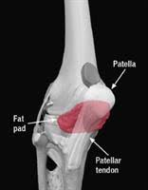

Slide 8
MCL Sprain
Caused by a blow to the outside of the knee or a high-energy twisting
S & Sx: swelling of the medial knee, tenderness over the MCL, pain
Tx: RICE, NSAID,a brace or crutches, tape and rehabilitation
Special Test: Valgus Stress

Slide 9
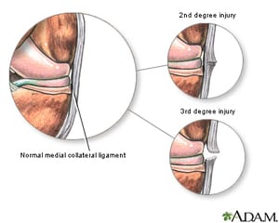

Slide 10
LCL Sprain
Caused by a blow to the inside of the knee or a high-energy twisting
S & Sx: swelling of the lateral knee, tenderness over the LCL, pain
Tx: RICE, NSAID,a brace or crutches, tape and rehabilitation
Special Test: Varus Stress

Slide 11
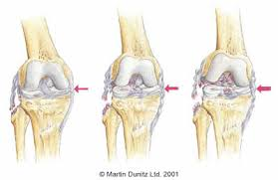

Slide 12
ACL Sprain
Can occur from contact or noncontact causes
S & Sx: hearing a “pop”, knee buckling, swelling, pain limited ROM
Tx: RICE, NSAIDs, a brace and crutches, rehabilitation
Special Tests: Anterior Drawer, Lachmans
Interesting fact: Females are more susceptible

Slide 13
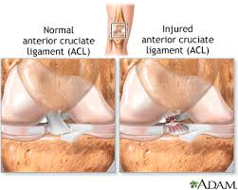

Slide 14
PCL Sprain
Most occur during a fall on the flexed (bent) knee with the foot plantar flexed or hyperflexion (bending too far) of the knee
S & Sx: hearing a “pop”, knee buckling, swelling, pain limited ROM
Tx: RICE, NSAIDs, a brace and crutches, rehabilitation
Special Test: Posterior Drawer, Sag Test

Slide 15
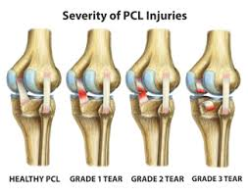

Slide 16
Meniscus Tear
Occur when the knee is twisted suddenly and one or both menisci become trapped between the femur and tibia
S & Sx: Slow and mild knee swelling, pain, popping, locking, or giving way of the knee
Tx: RICE, NSAIDs, crutches, activity modification, and rehabilitation
Special Test: McMurray’s Test and Apley’s Grind

Slide 17
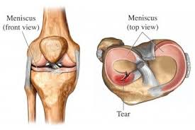
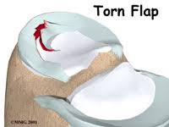
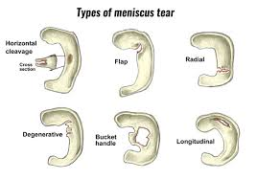

Slide 18
Epiphyseal (growth-plate) Injuries
Knee is subject to sports-induced trauma at the centers of bone growth in skeletally immature athletes
S & SX: Tender over growth plate, swelling, limited ROM
Tx: RICE, NSAIDs, immobilization
Interesting Fact: May alter the length of the affected bone

Slide 19
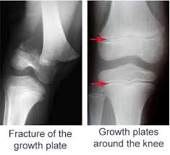

Slide 20
Iliotibial band syndrome
Occurs when there is inflammation of the iliotibial band. Usually occurs over the outside of the knee joint, at the lateral epicondyle
S & Sx: Pain w/ activity, clicking or rubbing sensation, lingering pain after activity, tenderness at insertion
Treatment: RICE, NSAIDs, ultrasound, stretch, rule out mechanical problems or training errors, proper footwear

Slide 21
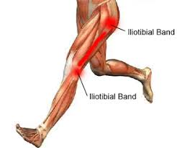

Slide 22
Patellar Dislocation
When the kneecap is completely out of its normal alignment (usually laterally)
Caused by a traumatic incident (often twisting or a direct blow) to the knee but may also be caused by:
History of patella dislocation or subluxation
Patellofemoral joint hyperlaxity, maltracking or shallow femoral groove
Weak inner quadriceps muscles and tight lateral muscles

Slide 23
Patellar Dislocation Cont.
S & Sx: Deformity, pain
Tx: Reduce, RICE, Refer

