Slide 1
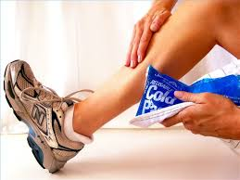
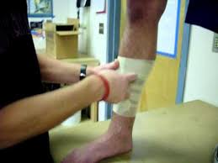
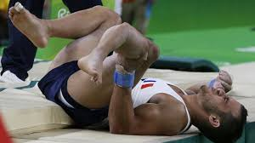
Lower Leg

Slide 2
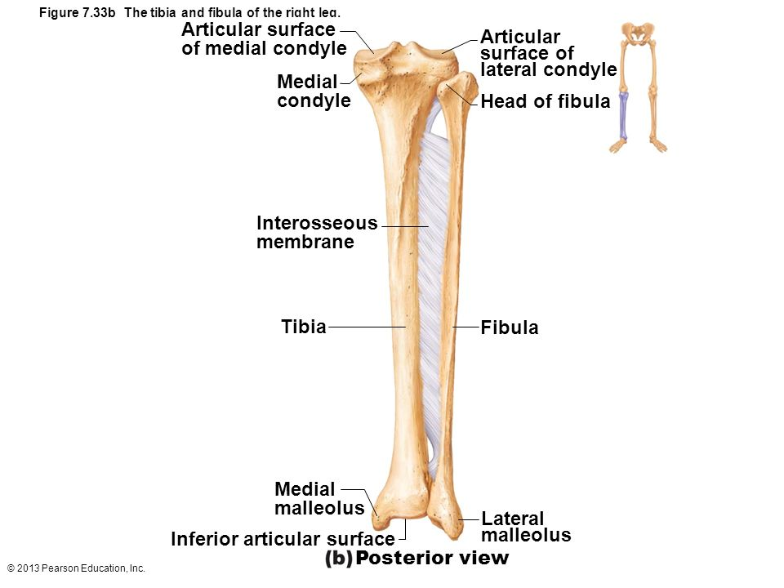
Anatomy: Lower Leg
Tibia (weight bearing)
Medial malleolus
Fibula (non-weight bearing)
Lateral malleolus
Interosseous Membrane
Connects the Tibia and Fibula

Slide 3
Anatomy: Muscles
Anterior
Tibialis anterior
Extensor hallucis longus
Extensor digitorum
Lateral
Peroneal longus, brevis and tertius
Deep Posterior
Tibialis posterior
Flexor digitorum longus
Flexor hallucis longus
Superficial Posterior
Gastrocnemius
Soleus
Plantaris

Slide 4
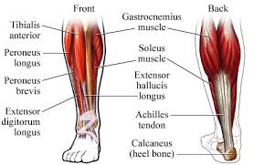

Slide 5
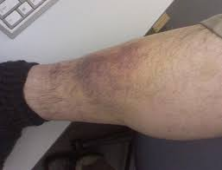
Conditions of the Lower Leg: Shin Bruise
The shin is susceptible to contusions because muscle or fat padding is not present in this area. The bone (tibia) receives the full blow.
Mechanism
Direct contact
Signs and Symptoms
Pain
Inflammation
Discoloration
Treatment
Ice
Padding

Slide 6
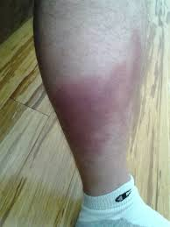
Conditions of the Lower Leg: Muscle Contusions
The gastrocnemius is the most affected
Mechanism
Direct contact
Signs and Symptoms
Pain
Weakness
Partial loss of function
Hard, rigid and inflexible
Treatment
Stretch to muscle
R.I.C.E

Slide 7
Conditions of the Lower Leg: Shin Splints
Pain in the lower leg
Predisposing Factors
Abnormal foot pronation
Falling arches
Muscle fatigue
Repetitive stress
Body chemical imbalance
Lack of coordination between and anterior and posterior muscles
Signs and Symptoms
Pain
Treatment
Ice massage
Cold whirlpool
Ultrasound
Stretching
Incline board
Orthotics
Taping

Slide 8
Conditions of the Lower Leg: Anterior Tibial Compartment Syndrome
A condition to which the circulation and function of the tissues within the compartment
Mechanism
Direct contact
Signs and symptoms
Increase in pressure in the compartment
Circulation is impaired
Tissue function is impaired
Intense pain
Hard and tender muscle
Signs and symptoms Continued
Passive plantar flexion is painful
Decreased sensation in the first and second toe
Weakness of anterior tibialis, extensor halluces longus, extensor digitorum, and the ankle evertors
Treatment
Slight pressure = ice, rest, observe
A lot of pressure = see a MD

Slide 9
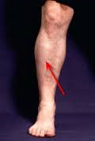
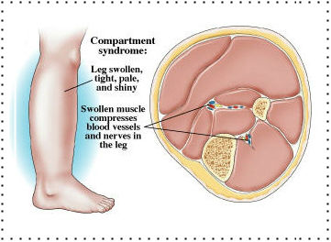

Slide 10
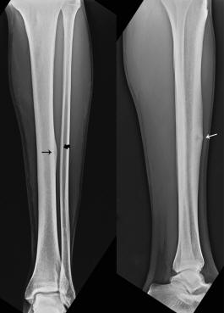
Conditions of the Lower Leg: Stress Fracture
Microfractures in the tibia, with continued stress may become a fracture
Mechanism
Overuse
Continued stress
Signs and symptoms
Severe pain
Disability in activity
Treatment
See a MD

Slide 11
Rehabilitation of the Lower Leg
ROM/Flexibility
Stretch all four compartments
Stretch Achilles Tendon
All ROM exercises for the ankle
Strength
Manual resistance
Weights
Toe raises
Towel curls
Marble pick up

Slide 12
