Slide 1
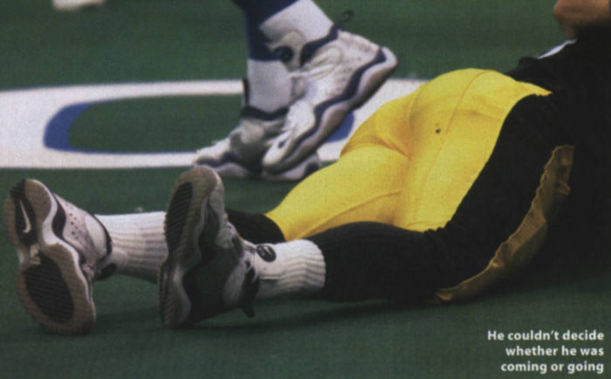
Mechanisms and Characteristics of Sports Trauma
“How did that happen?”

Slide 2
What You Will Learn
What actually happens within your body when you get injured.
What kinds of forces cause injury.
What the names are of common injuries.
What the normal structures of bone and soft tissue are.
The different types of wounds.
How your body heals after it is injured.

Slide 3
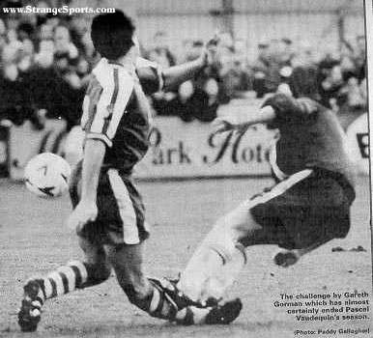

Slide 4
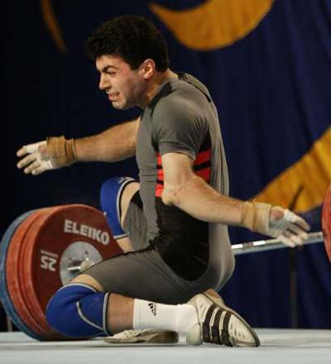

Slide 5
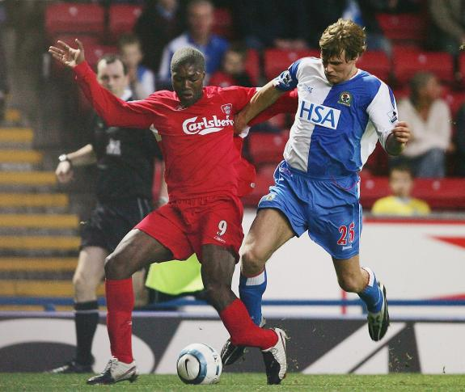

Slide 7
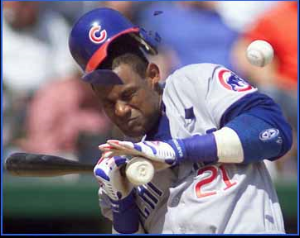

Slide 8
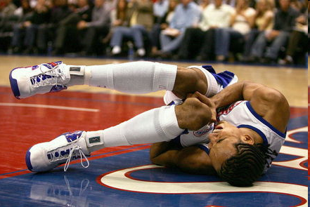

Slide 9
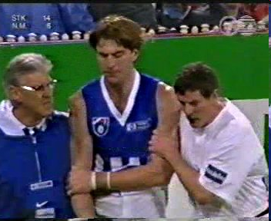

Slide 10
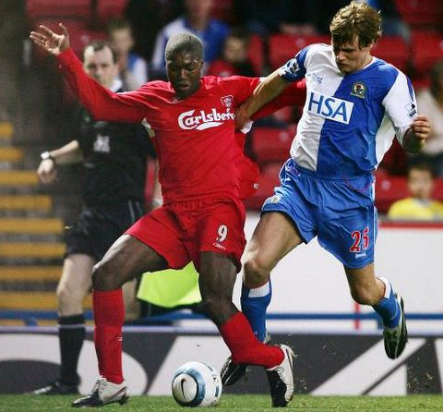
Mechanical Injury
With any injury, a force is placed on any part of the body resulting in the changing of function or structure.
Three types
Tension
Compression
Bending
Shear

Slide 11
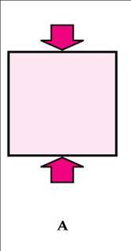
Mechanical Forces
Tension – a force that pulls or stretches the tissue.
Stretching beyond the YIELD POINT causes a structure to tear or break
LaffyTaffy
Compression – a force that, with enough energy crushes tissue
Compression fractures
Soda can
Bending – Compression and tension forces applied together upon a structure

Slide 12
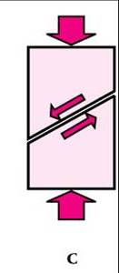
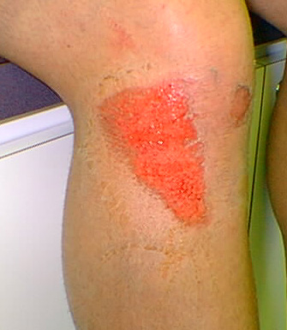
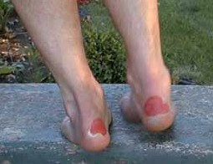
Mechanical forces
Shearing – a force that moves parallel with the tissue (oreo)
Blisters,
Abrasions, and
Disk Injuries

Slide 13
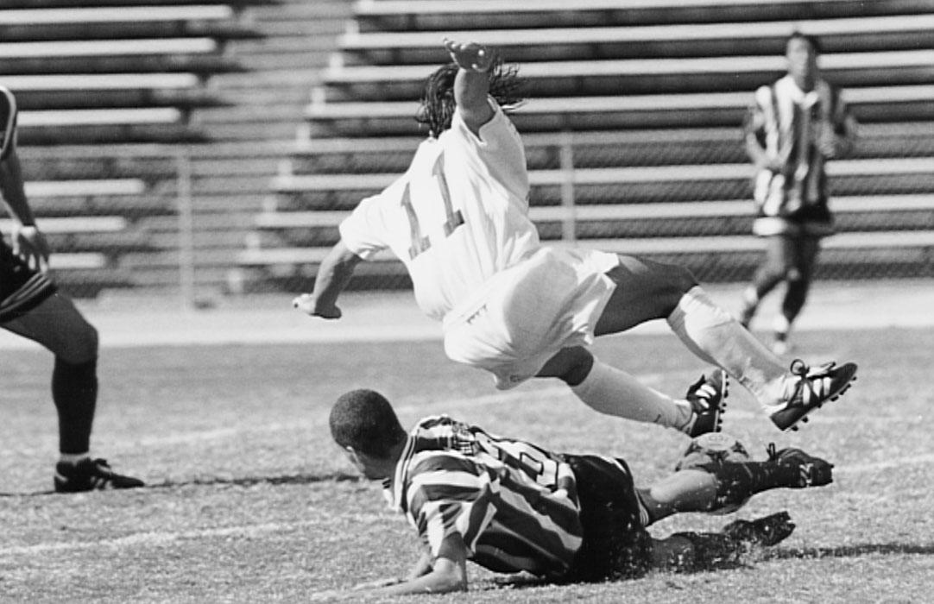
A soccer player (in this picture) has just made a slide tackle.
What types of forces are being applied?
What are some of the possible injuries that either player could receive from this motion?

Slide 14
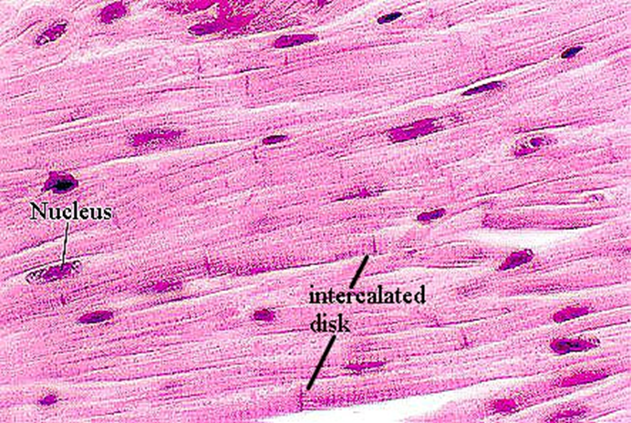
Muscle Types
● Cardiac
- Walls of the heart
- Voluntary

Slide 15
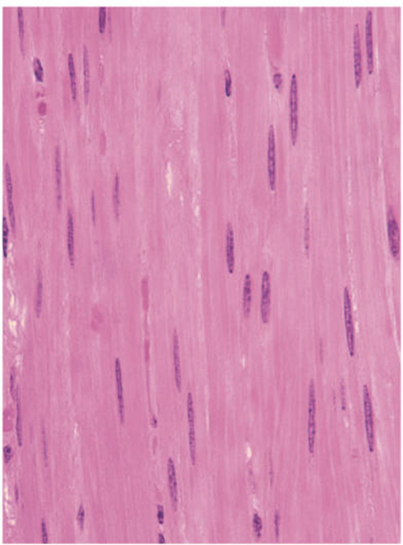
Muscle Types
Smooth/Visceral
Found in internal organs: respiratory tract, digestive tract, blood vessels and eyes
Long circular fibers – peristalsis
Smooth (no striations)
Involuntary

Slide 16
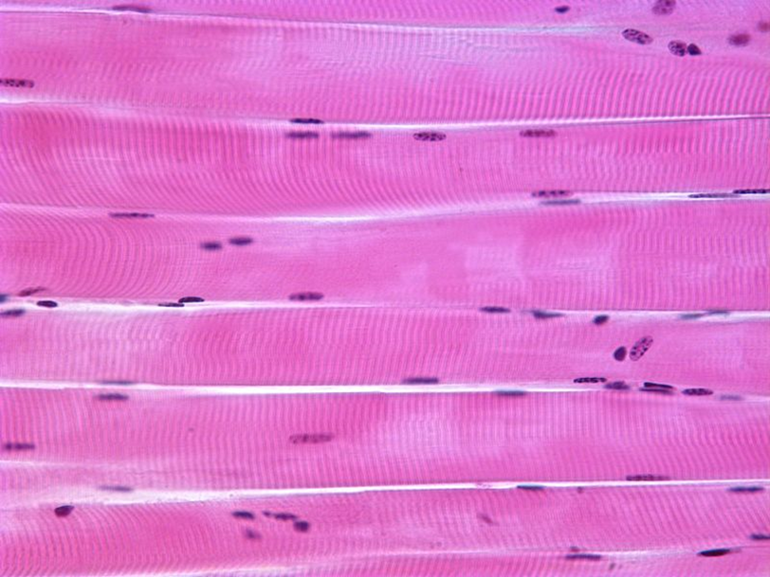
Muscle Type
Skeletal or striated
Attached to the bones to cause skeletal movement
Striated
VOLUNTARY

Slide 17
Muscle Tissue
Actin: protein which forms the thin filaments
Myosin: protein which forms the thick filaments
Myofibril: made up of actin and myosin myofilaments
Muscle fiber (muscle cell): groups of myofibrils encased in the endomysium
Fasciculus: groups of muscle fibers encased in the perimysium
Skeletal muscle: groups of fasiculi encased in the epimysium

Slide 18
Functions of Skeletal Muscle
Produce skeletal movement
Maintain posture and body movement (muscle tone)
Protect soft tissue: abdominal wall and pelvic floor
Maintain body temperature: ex. shivering

Slide 19
Characteristics of Muscle Tissue
Irritability/excitability: ability of a muscle to respond to a stimulus—nerve impulse
Contractibility: when stimulated muscles respond by contracting
Extensibility: ability to be stretched
Elasticity: ability to return to its normal shape after being stretched or contracted

Slide 20
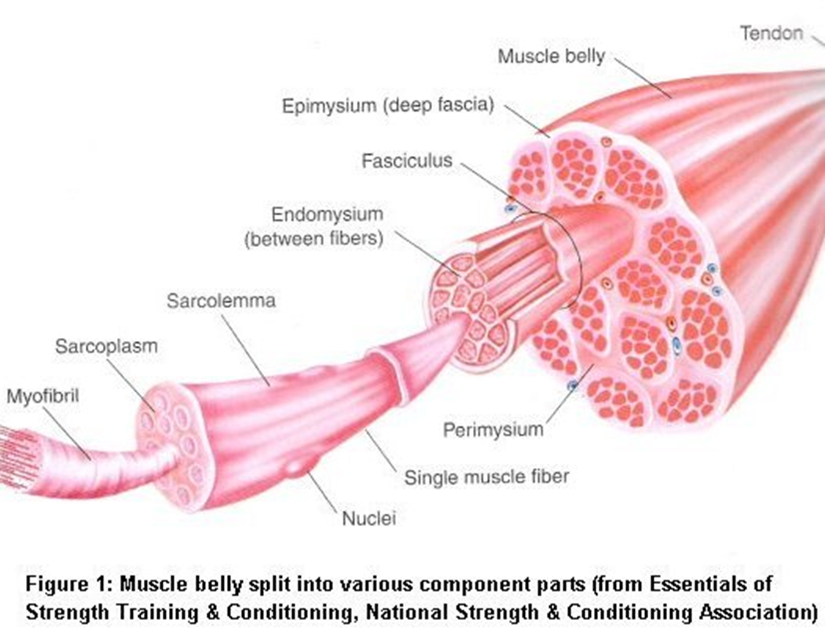

Slide 21
Types of Muscle Contraction
Isometric: same length – ex. Wall sits
Concentric: muscle shortens while contracting: ex. Bicep curl
Eccentric: muscle lengthens while contracting: bicep as you are lowering the weight

Slide 22
Strength of Muscle Contraction
Size: the larger the muscle the greater the strength of the contraction
Number of fibers: the more fibers that are recruited the greater the contraction
Neuromuscular efficiency: how well the nerve communicates with the muscle
Biomechanical factors: the angle of the joint

Slide 23
Cont.
Fast twitch v. Slow twitch:
Fast twitch muscle: quick forceful contraction but fatigues quickly
Slow twitch: slow rate of contraction over long period of time: resist fatigue
Level of physical activity: the more active the greater the contraction
Overtraining: overtraining can lead to a decrease in contraction strength

Slide 24
Points of Attachment
Origin: less moveable attachment point, usually more proximal
Insertion: more moveable attachment point, usually distal
Skeletal muscles are attached to bones by tendons

Slide 25
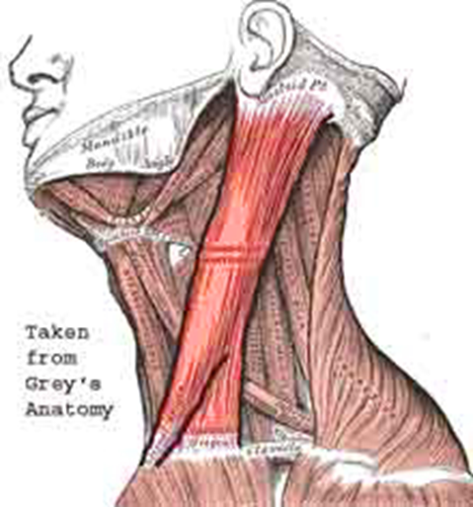
How Muscles are Names
Origin and insertion: sternocleidomastoid, is named for its attachment to the sternum, clavicle, and mastoid process

Slide 26
Location and Region
Pectoralis – chest
Gluteus – buttocks
Brachii – arm
Abdominus – abdomen
Femoris -- femur

Slide 27
Random Important Vocab
Action: flexor, extensor, adductor, abductor
Fibers: the direction that the fibers run
Rectus – straight, rectus abdominis
Tranverse – across, transversus abdominus
Oblique – diagonal, external oblique
Obiqularis – circular, obiqularis oris
Divisions
Bi = two, Tri = three, Quad = four

Slide 28
Size
Vastus: Huge, vastus lateralis
Maximus: large, gluteus maximus
Minimus: small, gluteus minumus
Longus: long, abductor pollicus longus
Brevis: short, abductor pollicus brevis

Slide 29
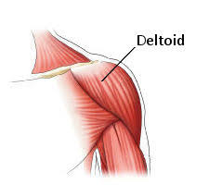
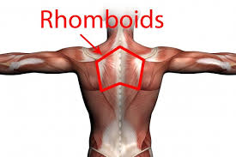
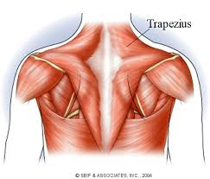
Shape
Deltiod: triangular
Rhomboid: rhombus
Trapezius: trapezoid

Slide 30
Categories Base on Action
Agonists: the prime mover, the muscle whose primary function is that particular movement
Synergist: helper, a muscle who assists the agonist in that movement
Anatagonist: a muscle who has the opposite movement of the agonist

Slide 31
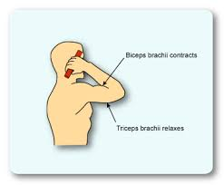
Example: for the movement of elbow flexion
Agonist: biceps brachii
Synergist: brachioradialis
Antagonist: triceps brachii

Slide 32
Muscle Strains
All Strains are graded on a 3 tier scale
Grade 1 – Mild
Local pain w/ little bruising (ecchymosis).
Little to no loss of strength.
Grade 2 – Moderate
Moderate pain/ bruising/ swelling
Impaired muscle function (i.e. limping)
Grade 3 – Severe
Loss of muscle function
Palpable defect

Slide 33
Cramps and Spasms
Cramp - A painful involuntary contraction of a skeletal muscle or muscle group.
Caused by ...
Spasm – reflex reaction caused by trauma
Clonic – contracting and relaxing
Tonic – constant contraction

Slide 34
Muscle Soreness
Acute Onset Muscle Soreness
Decreased circulation
Lactic Acid and potassium collect within the muscle
Which stimulate pain receptors
Delayed Onset Muscle Soreness
Caused most by eccentric exercise
Cell/ Fiber death within the muscle
Prevention
Good Warm-up
Extended cool down
Stretching before and after activity

Slide 35
Chronic Muscle Injuries
“ITIS”
An inflammation or irritation of the structure (tendonitis – irritation of the tendon)
Caused over a longer period of time by the wearing away of a structure or repeated acute injuries

Slide 36
Tendons
Join muscle to bone
^{Unloaded} ^{Loaded} ^{Yield point}
What happens when you stretch a slinky too far???
Tendons are actually 2x the strength of the muscle it serve. Therefore, injuries usually occur at the muscle or at the attachment.

Slide 37
Ligaments
Join bone to bone
Ligaments are thickest in the middle, so they usually tear at the ends.
Injuries to the ligaments usually happen when a constant stress is put on them over a period of time
Intermittent stress actually strengthens the ligaments.

Slide 38
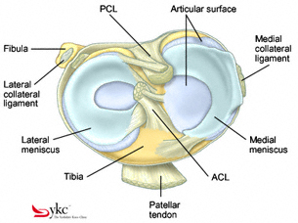
Cartilage
Cartilage is the shock absorber between two bones.
Injuries occur after repeated irregular stress

Slide 39
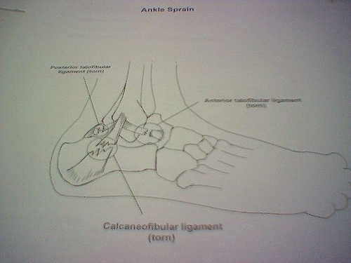
Injury Classifications
Sprain
Strain
Subluxation
Dislocations
Sprains are graded on a scale 1-3 just like strains.

Slide 40
Review Questions
As a runner, Jen puts a lot of daily stress on her knees, now her patellar tendon is irritated. That is called _____________
Sliding into home Mike scraped off the top layer of skin on his thigh and got pegged by the ball.
a. What forces were being applied?
b. What injuries did these forces cause?
3. When Jon ruptured (completely tore) his Achilles tendon, where did it most likely tear?
4. What would you recommend to someone who is constantly going to practice sore?

Slide 41
Stress Fractures
no specific cause but with a number of possible causes
Overload due to
muscle contraction,
altered stress distribution due to muscle fatigue,
changes in surface (shoes, surfaces, terrain)
rhythmic repetitive stress vibrations
Alternating events (not prepped for 2nd event)
Coming back to participation too soon

Slide 42
Stress Fx cont.
Bones get weaker before the become stronger, so if not conditioned well before intense practice starts….
Dx difficult due to gradual onset
Sx – swelling, local tenderness, pain w/ activity only, may progress to pain w/ activity and rest.
Tx – rest, ice, compression

Slide 43
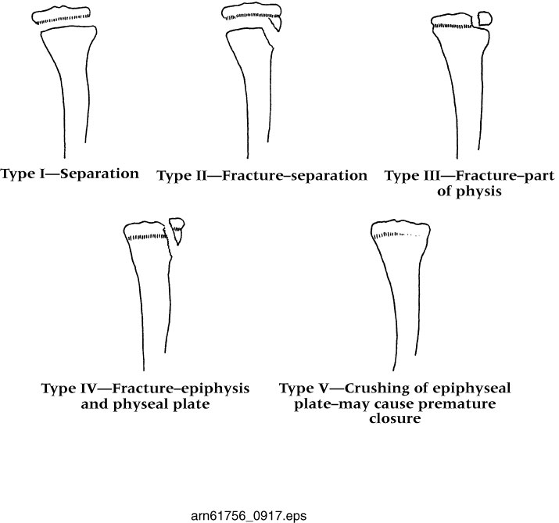
Epiphyseal (Growth) Plates
through age 16 or so
NOT GOOD!
growth probs.

Slide 44
Review
A bowling ball fell on your arm. What type of fracture do you most likely have?
What are 3 reasons that cross country runners see the most stress fractures of any other type of athlete?
Where is the bone weakest?
Why are we so concerned with younger athletes injuring themselves?

