Slide 1
SKELETAL SYSTEM

Slide 2
Common Skeletal Bones

Slide 3
Structure and Function
Functions of the skeletal system:
Provides shape and support
Protects internal organs
Stores minerals and fat
Produces blood cells and platelets
Assists in movement

Slide 4
Bones
Bone tissue is composed of:
Inorganic salts (calcium phosphate)
Water
Organic material (bone cells, blood vessels, nerves, and collagen)
Bone cells must continually receive food and oxygen
Bones continue to grow for the first 18 to
20 years of life
Bone cells die and are replaced by new ones

Slide 5
Bones (Continued)
Bones may have cartilage
Bones are attached to other bones by ligaments
Bones are joined to muscles by tendons

Slide 6
Types of Bones
Two major groups of bones
Axial skeleton
Includes 80 bones of the head and trunk
Appendicular skeleton
Includes 126 bones of the pelvis, shoulders, arms, and legs

Slide 7
Bones of the Body

Slide 8
Bones by Shape

Slide 9
Skull
Includes bones of the:
Cranium
Eight bones
Face
13 bones
Ear
The mandible is the only movable bone of the skull

Slide 10
Thorax
Thorax includes:
Ribs
Seven pairs of “true” ribs, five pairs of “false” ribs, and two pairs of “floating” ribs
Sternum
Vertebral bones
Protect the lungs and heart

Slide 11
Vertebral Column
Consists of five parts (total of 26 vertebrae):
Cervical vertebrae (7 vertebrae)
Thoracic vertebrae (12 vertebrae)
Lumbar vertebrae (5 vertebrae)
Sacrum
Coccyx
Curvature gives it strength and flexibility
Cartilage between vertebrae cushions bones
and allows movement

Slide 12
Vertebral Column (Continued)

Slide 13
Long Bones of the Extremities
Long bones of the arms and legs contain marrow
Makes blood cells for the body
Long bones grow and lengthen from a layer of cartilage (epiphyseal plate)
Shaft of the long bone (diaphysis) contains fatty tissue and yellow marrow
Fatty tissue provides stored energy

Slide 14
Long Bones of the Extremities (Continued)
End of the long bone contains red marrow that produces red blood cells
Red marrow destroys old red blood cells, forms white blood cells, and produces platelets
Periosteum (membrane)
Covers the bone
Contains osteoblasts
Medullary cavity
Contains osteoclasts which enlarge the diameter of the cavity by removing bone cells

Slide 15
Anatomy of a Long Bone

Slide 16
Bone Markings
Four major types of bone markings:
Projections bulge from a bone and attach to muscles, ligaments, and tendons
Openings are holes or spaces in bones
Depressions include openings and cavities in bone
Ridges are lines on a bone surface

Slide 17
Bone Markings (Continued)

Slide 18
Joints
Articulation
Two or more bones join together at a joint
Joints are named by the bones that are joined

Slide 19
Types of Joints
Three types of joints:
Immovable (synarthrosis)
Example: sutures of the cranium
Slightly movable (amphiarthrosis)
Bones of the pelvis
Freely movable (diarthrosis)

Slide 20
Types of Diarthrosis Joints
Ball and socket joints of the shoulders and hips
Hinge joints of the elbow and knee
Gliding joints of the wrists
Pivot joint at the base of the skull
Saddle joint of the thumb
Gomphosis, such as the attachment of a tooth in its socket in the jaw

Slide 21
Figure 14-9 Types of Joints (Continued)

Slide 22
Assessment Techniques
Bone x-rays
Bone marrow aspiration
Bone marrow biopsy
Radionuclide bone scan
Computed axial tomography (CAT)
Magnetic resonance imaging (MRI)
Bone densitometry

Slide 23
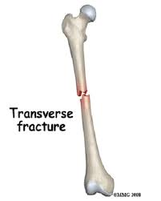
TRANSVERSE
Fracture that occurs perpendicular to the bone

Slide 24
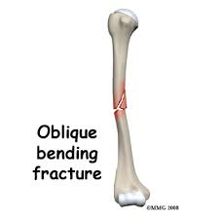
OBLIQUE
Fracture that’s neither perpendicular nor parallel to the bone

Slide 25
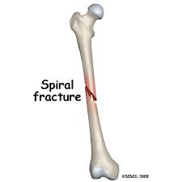
SPIRAL
Fracture where the bone has been twisted apart

Slide 26
GREENSTICK
Fracture in which the bone does not break completely (usually in children)

Slide 27
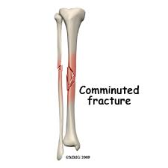
COMMINUTED
Fracture in which bone is broken in a number of pieces. This kind of fracture results from high energy impacts like auto accidents

Slide 28
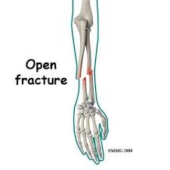
OPEN
Fracture in which bone breaks the skin

Slide 29
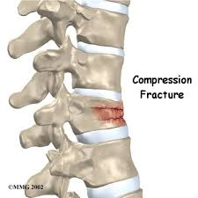
Compression
Fracture in which the bone compresses and condenses rather than breaking apart (most common in vertebrae)

Slide 30
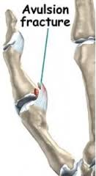
Avulsion
Fracture that occurs when a ligament or tendon pulls off a part of a bone during an injury

