Slide 1
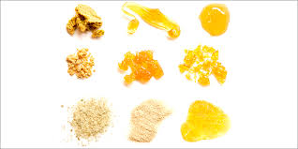
Cannabis Sativa
What is it
Marijuana is classified in its own drug classification. It can act as a stimulant, depressant or hallucinogen.
What does it look like?
Hemp (thick fibrous material used to make rope, paper & clothing)
Marijuana (dried greenish brown leaves)
Hashish (dark brown/black sticky tar)
Hashish oil (thick, dark oil)
Wax
Liquid THC

Slide 2
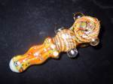
How does it enter your body?
Orally
Pill/Tablet/Capsule Form
Edible
Smoked
Joint (marijuana rolled in paper)
Blunt (marijuana rolled in tobacco)
Pipe (marijuana packed into the bowl of a pipe)
Bong “water pipe”
Vaporizer/E pen

Slide 3
What is in it?
Tetra Hydro Cannabinol (THC)
The higher the level of THC the greater the high = the higher the cost
The lower the level of THC the weaker the high = the lower the cost
Is it addicting?
YES! 1:10 users will become addicted. If people start using under 18 the number drops to 1:6
Can you overdose on Marijuana?
Unlikely! You can overdose on other drugs that may be laced with the marijuana. But...

Slide 4
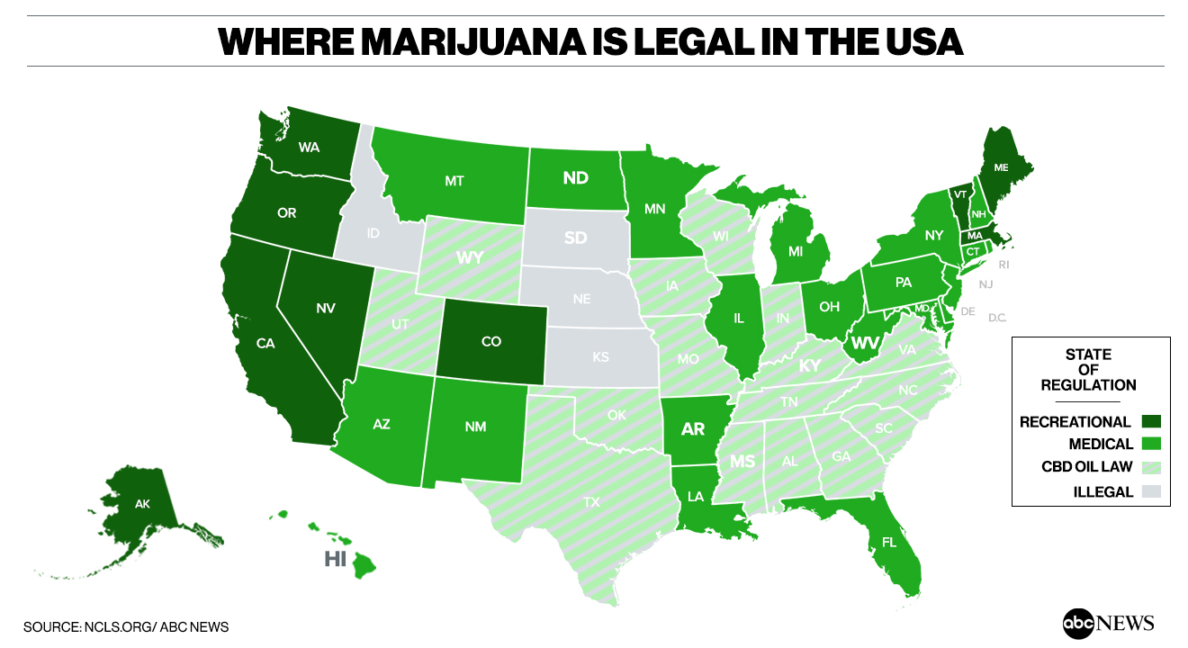
Is it legal?
NO! Huh What???
What about medical marijuana?
Used to assist individuals suffering from:
Glaucoma
Terminal cancer
HIV/AIDS

Slide 5
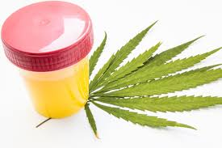
How long does your high last?
This depends on the quantity and quality of the drug.
How long does marijuana stay in your system?
Marijuana/hashish is FAT soluble. It can remain in you system for approximately 28 days.

