Slide 1
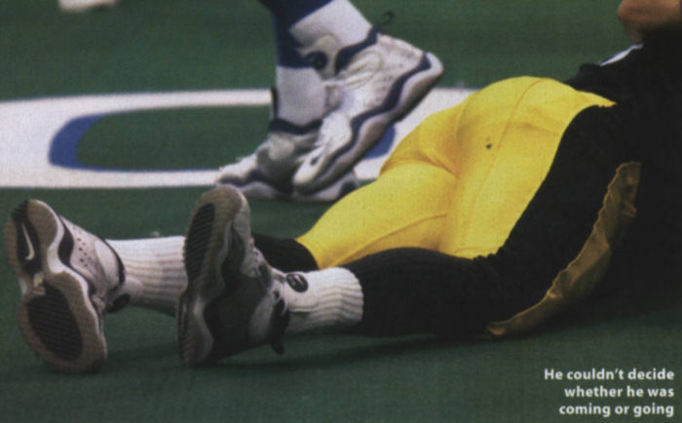
Mechanisms and Characteristics of Sports Trauma
“How did that happen?”

Slide 2
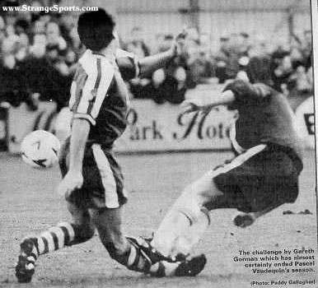

Slide 3
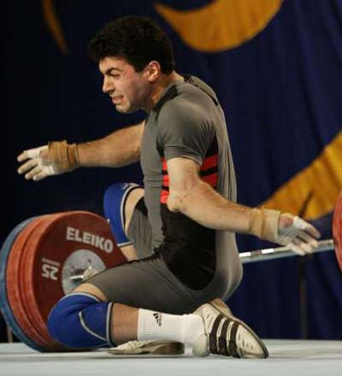

Slide 4
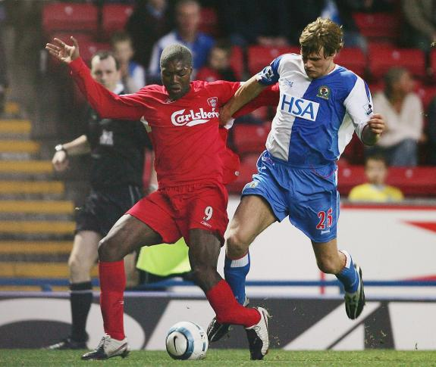

Slide 6
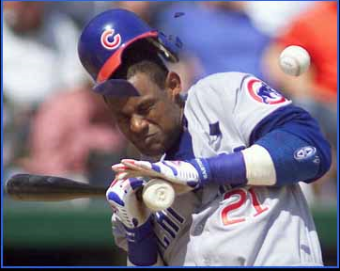

Slide 7
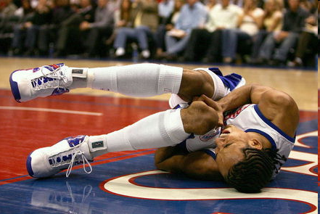

Slide 8
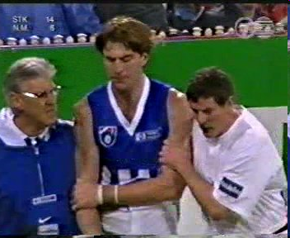

Slide 9
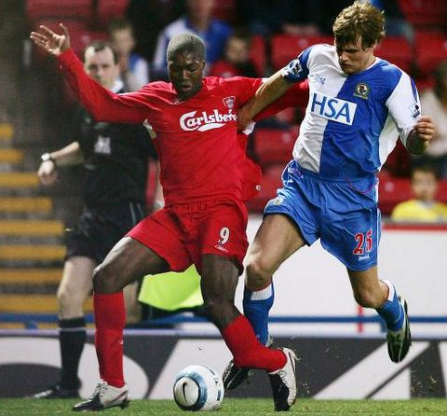
Mechanical Injury
With any injury, a force is placed on the body resulting in change of function or structure.

Slide 10
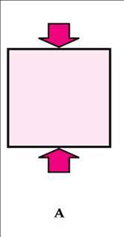
Mechanical Forces
Tension – a force that pulls or stretches the tissue.
Stretching beyond the YIELD POINT causes a structure to tear or break
LaffyTaffy
Compression – a force that, with enough energy crushes tissue
Compression fractures
Soda can
Bending – Compression and tension forces applied together upon a structure

Slide 11
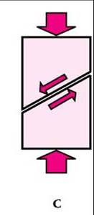
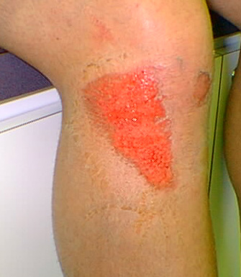
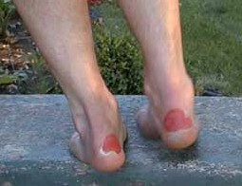
Mechanical forces
Shearing – a force that moves parallel with the tissue (oreo)
Blisters,
Abrasions, and
Disk Injuries

Slide 12
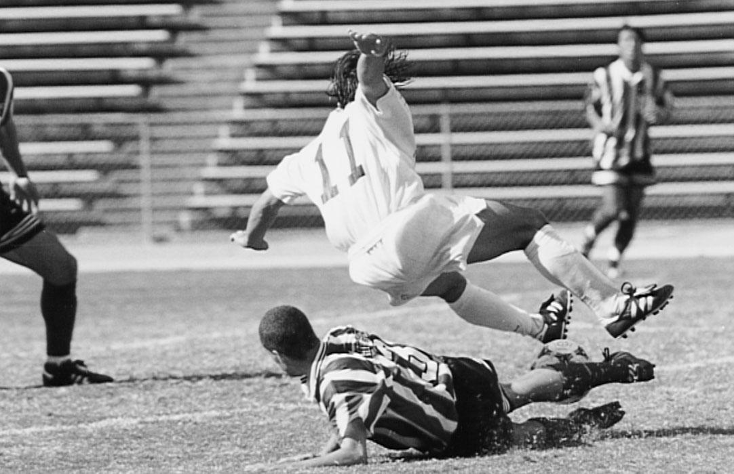
A soccer player (in this picture) has just made a slide tackle.
What types of forces are being applied?
What are some of the possible injuries that either player could receive from this motion?

Slide 13
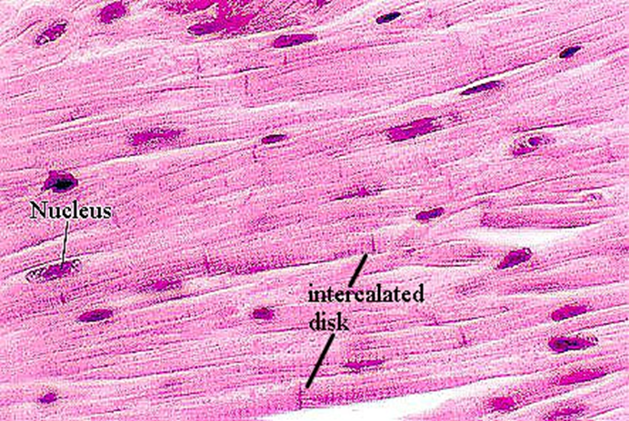
Muscle Types
● Cardiac
- Walls of the heart
- Involuntary

Slide 14
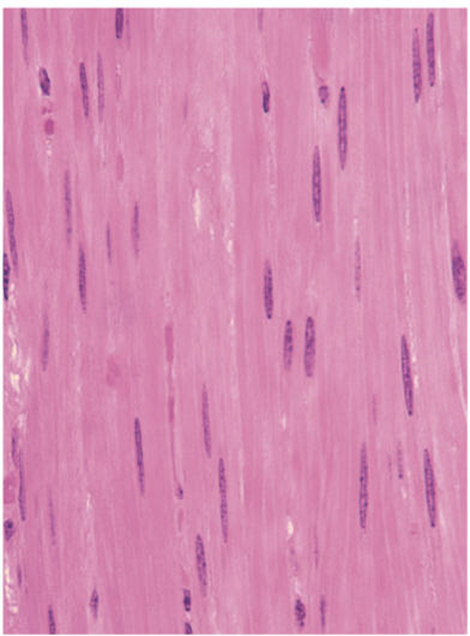
Muscle Types
Smooth/Visceral = no striations
Found in internal organs: respiratory tract, digestive tract, blood vessels and eyes
Involuntary

Slide 15
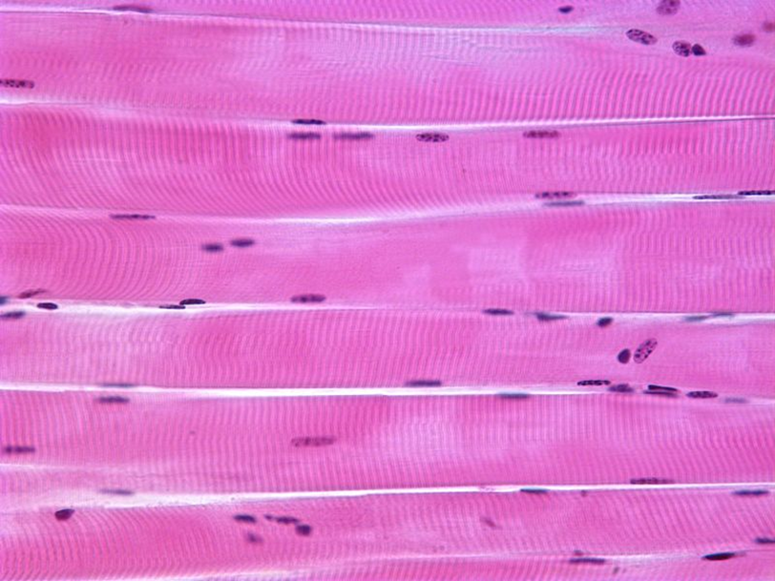
Muscle Type
Skeletal = striated
Attached to the bones to cause skeletal movement
VOLUNTARY

Slide 16
Functions of Skeletal Muscle
Produce skeletal movement
Maintain posture
Protect soft tissue: ex. abdominal wall and pelvic floor
Maintain body temperature: ex. shivering

Slide 17
Characteristics of Muscle Tissue
Irritability/excitability: ability of a muscle to respond to a stimulus
Contractibility: when stimulated muscles respond by contracting
Extensibility: ability to be stretched
Elasticity: ability to return to its normal shape after being stretched or contracted

Slide 18
Types of Muscle Contraction
Isometric: same length – ex. Wall sits
Concentric: muscle shortens while contracting: ex. Bicep curl
Eccentric: muscle lengthens while contracting: bicep as you are lowering the weight

Slide 19
Strength of Muscle Contraction
Size: the larger the muscle the greater the strength of the contraction
Number of fibers: the more fibers that are recruited the greater the contraction
Neuromuscular efficiency: how well the nerve communicates with the muscle
Biomechanical factors: the angle of the joint

Slide 20
Cont.
Fast twitch muscle: quick forceful contraction but fatigues quickly
Slow twitch: slow rate of contraction over long period of time fatigues more slowly
Level of physical activity: the more active the greater the contraction
Overtraining: overtraining can lead to a decrease in contraction strength

Slide 21
Points of Attachment
Origin: less moveable attachment point, usually more proximal
Insertion: more moveable attachment point, usually distal
Skeletal muscles are attached to bones by tendons

Slide 22
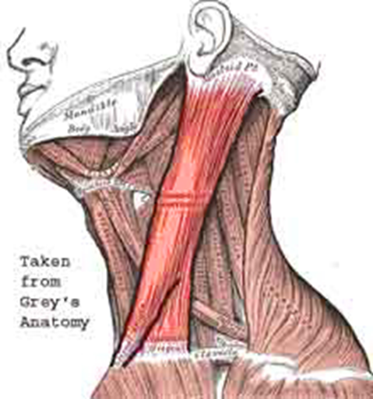
How Muscles are Named
Origin and Insertion
Sternocleidomastoid, is named for its attachment to the sternum, clavicle, and mastoid process

Slide 23
How Muscles are Named Cont.
Location and Region
Pectoralis – chest
Gluteus – buttocks
Brachii – arm
Abdominus – abdomen
Femoris -- femur

Slide 24
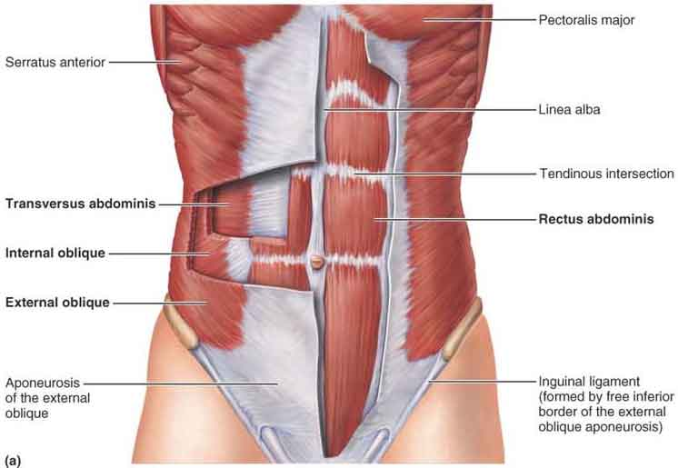
Random Important Vocab
Action: flexor, extensor, adductor, abductor
Rectus: straight (i.e. rectus abdominis)
Transverse: across (i.e. transversus abdominis)
Oblique: diagonal (i.e. external oblique)
Orbicularis: circular (i.e. orbicularis oris)
Divisions
Bi = two, Tri = three, Quad = four

Slide 25
Size
Vastus: Huge, vastus lateralis
Maximus: large, gluteus maximus
Minimus: small, gluteus minumus
Longus: long, abductor pollicus longus
Brevis: short, abductor pollicus brevis

Slide 26
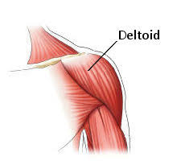
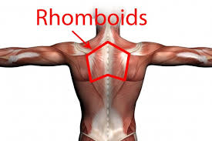
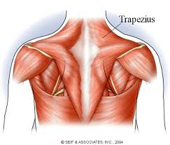
Shape
Deltiod: triangular
Rhomboid: rhombus
Trapezius: trapezoid

Slide 27
Categories Base on Action
Agonists: the prime mover
Synergist: helper
Anatagonist: a muscle who has the opposite movement of the agonist

Slide 28
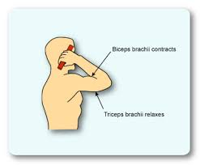
Example: for the movement of elbow flexion
Agonist: biceps brachii
Synergist: brachioradialis
Antagonist: triceps brachii

Slide 29
Muscle Strain (injury to muscle/tendon)
Muscle Sprain (injury to ligament)
All Strains & Sprains are graded on a 3 tier scale
Grade 1 – Mild
Local pain w/ little bruising (ecchymosis).
Little to no loss of function or strength.
Grade 2 – Moderate
Moderate pain/ bruising/ swelling (edema)
Impaired function and/or strength (i.e. limping)
Grade 3 – Severe
Loss of function and/or strength
Palpable defect (something you can feel)

Slide 30
Cramps and Spasms
Cramp - A painful involuntary contraction of a skeletal muscle or muscle group.
Caused by ...
Spasm – reflex reaction caused by trauma
Clonic – contracting and relaxing
Tonic – constant contraction

Slide 31
Muscle Soreness
Acute Onset Muscle Soreness
Decreased circulation
Lactic Acid and potassium collect within the muscle
Which stimulate pain receptors
Delayed Onset Muscle Soreness
Caused most by eccentric exercise
Cell/ Fiber death within the muscle
Prevention
Good Warm-up
Extended cool down
Stretching before and after activity

Slide 32
Chronic Muscle Injuries
“ITIS”
An inflammation or irritation of the structure (tendonitis – irritation of the tendon)
Caused over a longer period of time by the wearing away of a structure or repeated acute injuries

Slide 33
Tendons
Join muscle to bone
^{Unloaded} ^{Loaded} ^{Yield point}
What happens when you stretch a slinky too far???
Tendons are actually 2x the strength of the muscle it serve. Therefore, injuries usually occur at the muscle or at the attachment.

Slide 34
Ligaments
Join bone to bone
Ligaments are thickest in the middle, so they usually tear at the ends.
Injuries to the ligaments usually happen when a constant stress is put on them over a period of time
Intermittent stress actually strengthens the ligaments.

Slide 35
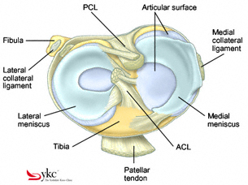
Cartilage
Cartilage is the shock absorber between two bones.
Injuries occur after repeated irregular stress

Slide 36
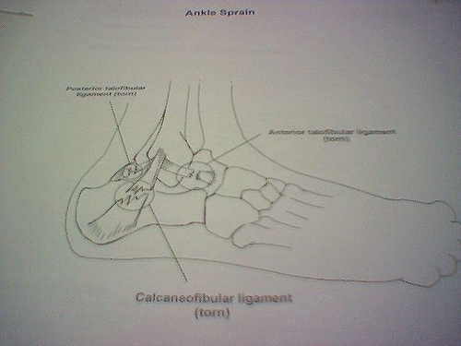
Injury Classifications
Sprain
Strain
Subluxation
Dislocations

Slide 37
Review Questions
As a runner, Jen puts a lot of daily stress on her knees, now her patellar tendon is irritated. That is called _____________
Sliding into home Mike scraped off the top layer of skin on his thigh and got pegged by the ball.
a. What forces were being applied?
b. What injuries did these forces cause?
3. When Jon ruptured (completely tore) his Achilles tendon, where did it most likely tear?
4. What would you recommend to someone who is constantly going to practice sore?

Slide 38
Stress Fractures (Fx)
There is no specific cause but with a number of possible causes...such as:
Overload due to
muscle contraction,
altered stress distribution due to muscle fatigue,
changes in surface (shoes, surfaces, terrain)
rhythmic repetitive stress vibrations
Alternating events (not prepped for 2nd event)
Coming back to participation too soon

Slide 39
Stress Fx cont.
Bones get weaker before they become stronger, so if not conditioned well before intense practice starts….
Diagnosis (Dx) is difficult due to gradual onset
Symptoms (Sx) – swelling, local tenderness, pain w/ activity only, may progress to pain w/ activity and rest.
Treatment (Tx) – rest, ice, compression

Slide 40
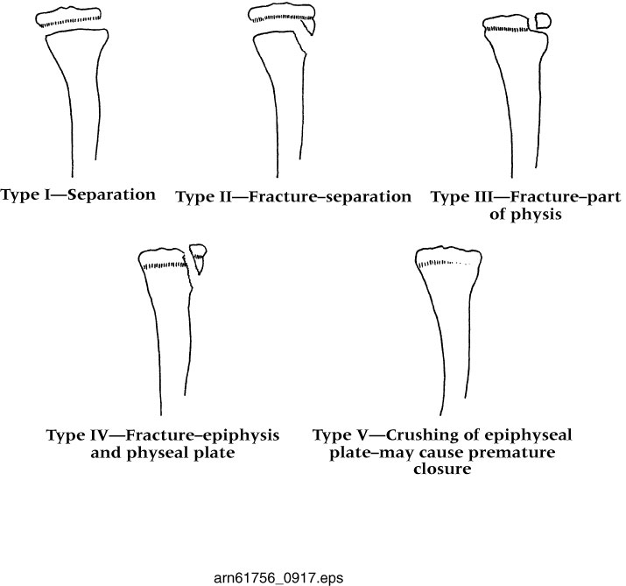
Epiphyseal (Growth) Plates
through age 16 or so
NOT GOOD!
growth probs.

Slide 41
Review
What are 3 reasons that cross country runners see the most stress fractures of any other type of athlete?
Why are we so concerned with younger athletes injuring themselves?

