Slide 1
HOPS

Slide 2
HOPS
Systematic and standardized procedure used to evaluate injuries.
Why?
Reduces risk of “missing something”
Allows easy communication of findings to all sports medicine personnel

Slide 3
HOPS
History
Observation
Palpation
Special Tests
Sometime it is referred to as HIPS (history, inspection, palpation and special tests)

Slide 4
HISTORY
First step
Done before you ever touch the athlete
Use information gained during this phase to guide the rest of the evaluation
Questions should answer the following:
How did injury occur
When did injury occur
Did you hear anything: pops, grating, etc.
Did you feel anything: give out, pop out, burning, numbness, etc.
What have you done for it: ice, heat, NSAIDs
Type and location of pain

Slide 5
INSPECTION
Second part of the evaluation
You still have not touched the athlete
Why do you think that the athletic trainer still has not touched the injured athlete?
This phase can be done as soon as you see the athlete walk in the door, or as you walk onto the field, and can be partially done while taking the history.
Compare everything bilaterally
Why?

Slide 6
INSPECTION
During the inspection you are LOOKING for clues that tell you about the injury
Swelling (type, location, amount)
Discoloration
Deformities
Gait/weight-bearing
Posture
Scars from previous injuries
Bleeding
What should you do if you see bleeding?

Slide 7
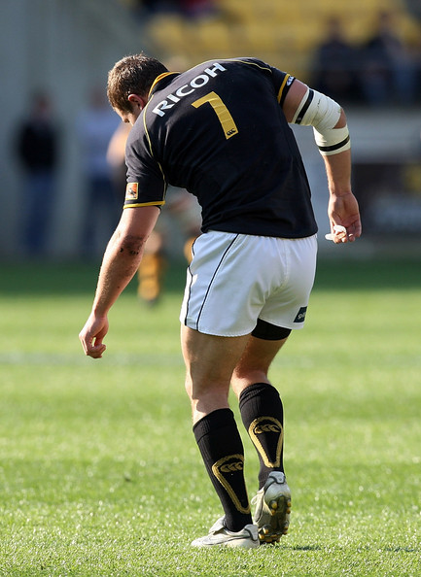
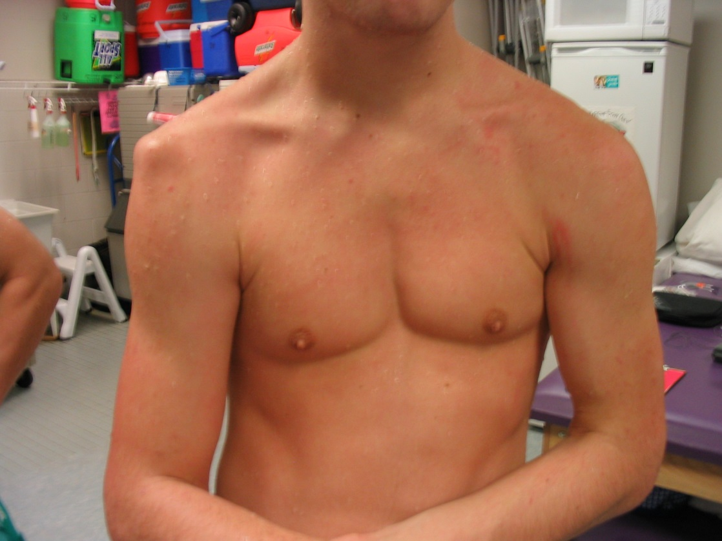

Slide 8
Palpation
This is the first time you actually touch the athlete
You use the information you gained during the history and inspection to guide you
Now you are FEELING for clues about the injury
You always palpate the uninjured side first
Why?
Then you palpate the injured side starting away from the area of most pain.
Why?

Slide 9
Palpation
Remember to observe universal precautions if your inspection revealed blood or body fluids
Things you are looking for during palpation
Temperature changes: hot or cold
Deformities
Point tenderness
Crepitice
Swelling (wet diaper vs. water balloon)
Rule out fractures

Slide 10
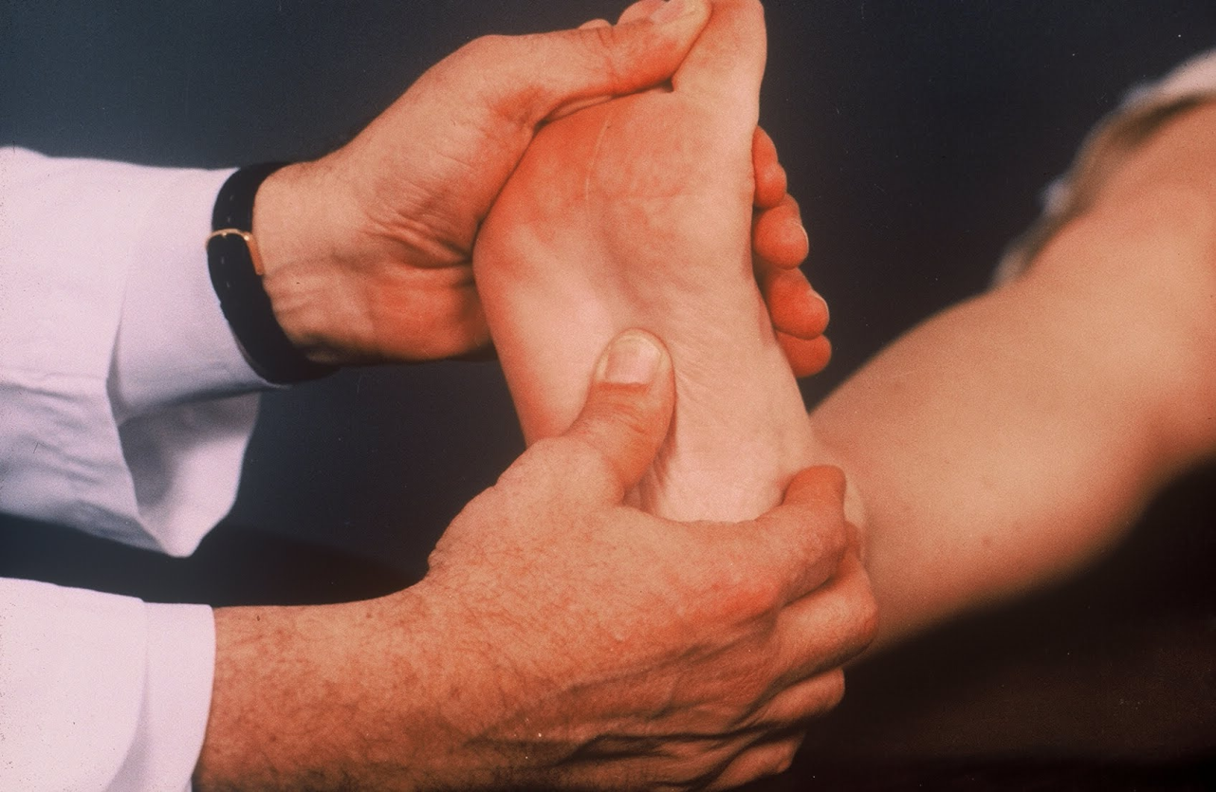
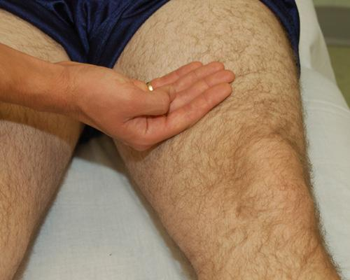

Slide 11
SPECIAL TESTS
The tests used in this section will be different for each body part that we cover
Remember to perform each test bilaterally
In general the tests are used to determine
Joint range of motion
Muscle strength and function
Ligament stability
Nervous function/integrity

Slide 12
ROM & Muscle Testing
Used to determine if the range of motion of a joint is within normal limits
Always test bilaterally
Three ways to test range of motion– test them in this order
Active—the athlete move the joint themselves
Passive– the athlete is relaxed and you move the joint through the ROM
Resistive-- you apply resistance while the athlete moves the joint

Slide 13
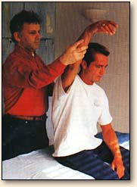
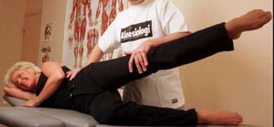

Slide 14
Ligamentous Tests
Tests used to determine the integrity of specific ligaments
We will learn specific tests during future units
Results of these tests, along with the history, inspection and palpation will allow you to “grade” sprains

Slide 15
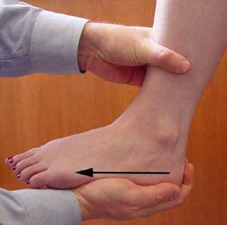
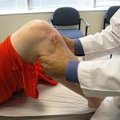

Slide 16
Grades of Sprains
Grade I
Ligament testing reveals solid endpoint (rope)
Grade II
Ligament testing reveals soft endpoint (bungee)
Grade III
Ligament testing reveals no endpoint (nothing)

Slide 17
Neurologic Testing
Dermatomes: an area of skin mainly supplied by a single spinal nerve
Myotomes: a group of muscle mainly supplied by a single spinal nerve
Reflexes
Peripheral nerve testing

Slide 18
Communication
Remember to respect the athlete’s privacy and HIPAA
Only communicate with people directly involved with the athlete– parents, coach, team doctor, etc.
Do not give specific information to the media
Store your evaluation in a secure place – athlete’s secured file, secured computer

