Slide 1
The Foot

Slide 2
Anatomy: Bones
Tarsals: 7 bones which make up the back portion of the foot
Talus
Calcaneus
Cuboid
Navicular
3 Cuneiform
Metatarsals
5 metatarsals articulate proximally with the tarsals and distally with the phalanges
Phalanges
14 phalanges; each toes has 3 phalanges and the great toe has 2
Sesamoid
There are 2 sesamoid bones under the first metatarsophanlangeal joint. They are designed to reduce pain on weight bearing and act as a pully system for the tendons

Slide 3
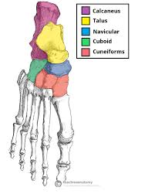

Slide 4
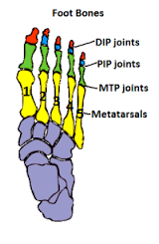

Slide 5
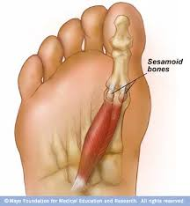

Slide 6
Anatomy: Arches
Medial Longitudinal Arch (Inner Arch)
Originates on the medial side of the calcaneus and extends to the first metatarsal
Lateral Longitudinal Arch (Outer Arch)
Originates on the lateral side of the calcaneus and extends to the 4th and 5th metatarsals
Transverse Arch
Formed by the cuboid and cuneiform bones
Anterior Metatarsal Arch
Formed by the distal heads of the metatarsals

Slide 7
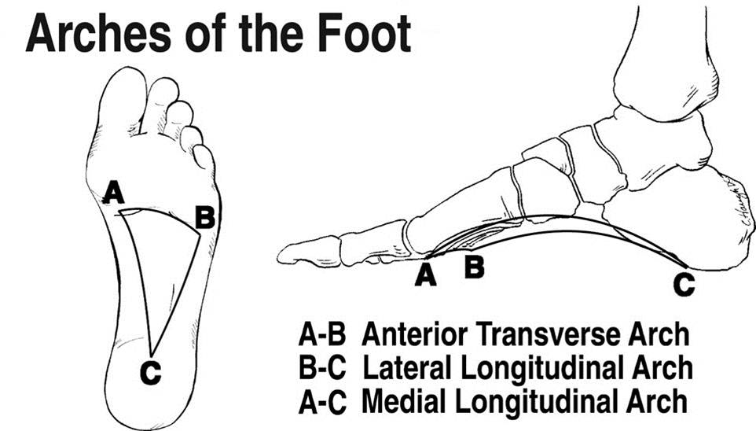

Slide 8
Anatomy: Ligaments
Calcaneonavicular (Spring)
Maintains the medial longitudinal arch
Plantar Fascia
A Tight band of tissue running from the calcaneus to the metatarsals

Slide 9
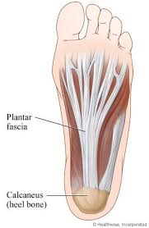

Slide 10
Movement of the Phalanges
Flexion (Bent)
Extension (Straightened)
Abduction (Out)
Adduction (In)

Slide 11
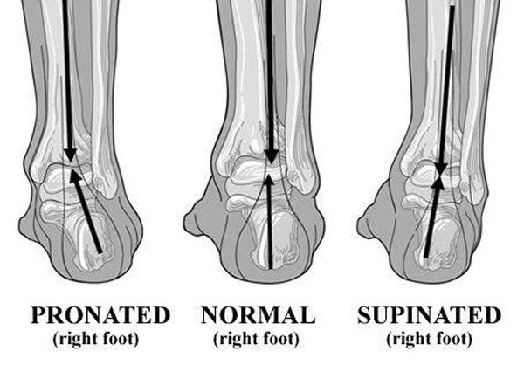
Foot Motions
Pronation
Supination

Slide 12
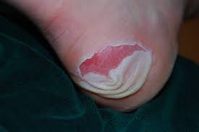
Conditions of the Foot: Blisters
Formed as a result of friction. Skin layers separate and fluid accumulates between the layers
Predisposing Factors
Improperly fitted shoes
Abnormal foot functions
Treatment
Clean area
Apply a topical antibiotic
Second skin can be placed on the area
A “donut” made from felt or foam rubber may be used to protect the area
Cover the blister

Slide 13
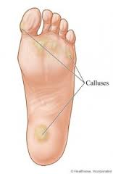
Conditions of the Foot: Calluses
Found on the plantar aspect of the foot.
Predisposing Factor
Friction produced by shoes rubbing on bony prominences
Treatment
Properly fitted shoes
Wear two pair of socks
File calluses

Slide 14
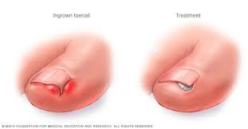
Conditions of the Foot: Ingrown Toenail
Nail plate grows into the surrounding tissue
Predisposing Factor
Direct trauma to the toe
Improperly fitted shoes
Incorrect cutting of the nail
Treatment
Soak the foot in warm water
Place a small amount of cotton under the nail
See a physician

Slide 15
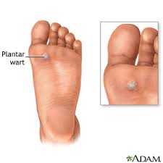
Conditions of the Foot: Plantar Wart (Verruca Plantaris)
Found on the sole of the foot
Predisposing Factor
Walking barefoot where exposure to a wart-causing virus is common, such as a public shower
Signs and Symptoms
Pain
Point tenderness
Excessive thickening of the skin
Cluster of small black dots
Treatment
Wear a protective donut
See a physician

Slide 16
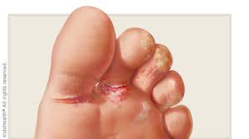
Conditions of the Foot
Athletes Foot (Tinea Pedis)
A contagious fungus infection found on the soles of the foot or in the webs of the toes
Predisposing Factor
Moist feet
Reuse of dirty socks
Use of locker rooms or public showers
Signs and Symptoms
Extreme itching
Rash with small pimples or blisters
Swelling
Red, white or grey scaling
Treatment
Keep feet dry
Wear clean socks
Use a fungicide

Slide 17
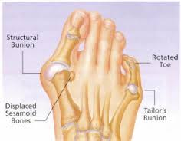
Conditions of the Foot: Bunion
Bunion (Hallux Valgus) is a deformity of the great toe. The metatarsophalangeal joint becomes enlarged and the great toe moves towards the 2nd toe.
Bunionette (Tailors Bunion) the 5th toe angles towards the 4th toe.
Predisposing Factors
Congenital
Improperly fitted shoes
Signs and Symptoms
Pain and tenderness
Swelling
Enlargement of the joint
Treatment
Properly fitted shoes
Pad the medial side of the joint
Tape (wedge the toes)
Warm bath or ice
Exercise to strengthen the extensors and flexor muscles

Slide 18
Conditions of the Foot: Heel Bruise
Contusion to the heel, usually on the plantar surface
Mechanism
Sudden stop and go response
Moving suddenly form the horizontal to the vertical
Wrinkle or small rock in your shoe
Signs and symptoms
Severe pain
Disability in weight bearing
Swelling
Treatment
Ice massage
Heel cup or a donut pad

Slide 19
Conditions of the Foot: Plantar Fasciitis
A partial or complete tear of the bottom of the foot
Mechanism
Sudden excessive loading
Chronic excessive pronation
Weak ankles
Poor arch supports
Poor fitting shoes
Signs and symptoms
Pain under heel bone
Tenderness
Swelling near heel
Treatment
R.I.C.E
Tape
Orthotics

Slide 20
Conditions of the Foot: Sprained Toe (Turf Toe)
A sprain of the 1st MTP (Sprain of the big toe)
Mechanism
Hyperextension of the MTP joint
Gradually gets worse with repetitive force
Predisposing Factors
Improper shoes
Artificial grass
Signs and symptoms
Pain
Swelling
Limited movement
May hear or feel a POP
Treatment
Ice
Tape
Rest
Alter shoe

Slide 21
Conditions of the Foot: Fracture
Bone in the foot is broken
Mechanism
Trauma to the foot
“Stubbing toe”
Dropping object on foot
High impact (car accident)
Signs and symptoms
Pain
Swelling
May hear or feel a POP
Limited/No ability to bear weight
Treatment
R.I.C.E
See Physician

