Slide 1
The Knee
Bones, Ligaments, Muscles, & Soft Tissue
Notes:
1

Slide 2
Bones
Tibia: Medial side of the lower leg; Tibial Tuberosity
Fibula: Lateral side of the lower leg; Fibular Head
Femur: “Thigh” bone, very strong; Med/Lat Condyles
Patella: “Knee Cap”
Notes:
2

Slide 3
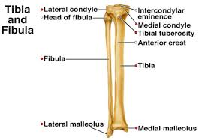
Bones
Notes:
3

Slide 4
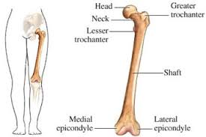
Bones
Notes:
4

Slide 5
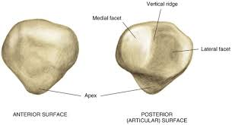
Bones

Slide 6
Ligaments
Anterior Cruciate Ligament (ACL)
Prevents the femur from moving posteriorly during weight bearing, prevents tibial internal rotation, works with muscular structures to stabilize the knee.
Posterior Cruciate Ligament (PCL)
Prevents hyperextension of the knee, anterior movement of the femur, resists internal tibial rotation *Main stabilizer in the knee
Medial Collateral Ligament (MCL)
Prevents valgus and external rotating forces *Most injured ligament in the knee
Lateral Collateral Ligament (LCL)
Prevents varus forces *Least injured ligament in the knee
Notes:
6

Slide 7
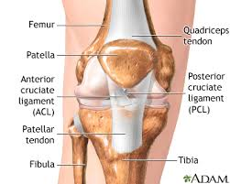
Anterior View
Notes:
7

Slide 8
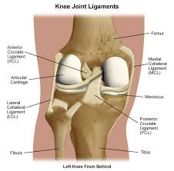
Posterior View

Slide 9
Muscles and their actions
Quadriceps – Performs knee extension
Located on Anterior Femur
Made up of 4 muscles
Vastus Lateralis
Vastus Intermedius
Vastus Medialis
Rectus Femoris (also a hip flexor)
Hamstrings – Performs knee flexion
Located on posterior femur
Made up of 3 muscles
Biceps Femoris (lateral)
Semitendinosus ( lies on top of the membranousus)
Semimembranosus (medial)

Slide 10
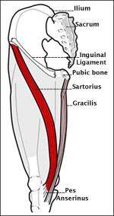
Muscles and their actions
Sartorius –
Located on anterior thigh, sits on top of quads, goes diagonal from lateral to medial
Performs Knee flexion
Gracilis –
Located on medial thigh
Performs Adduction
Pes Anserinus
AKA Goose Foot
Where Gracilis, Sartorius and
semitendinosus
“Gastroc”nemius –
Also a calf muscle
Knee Flexion
Notes:
10

Slide 11
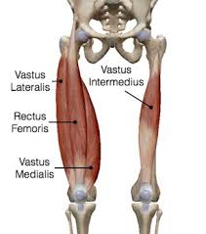
Anterior View
Notes:
11

Slide 12
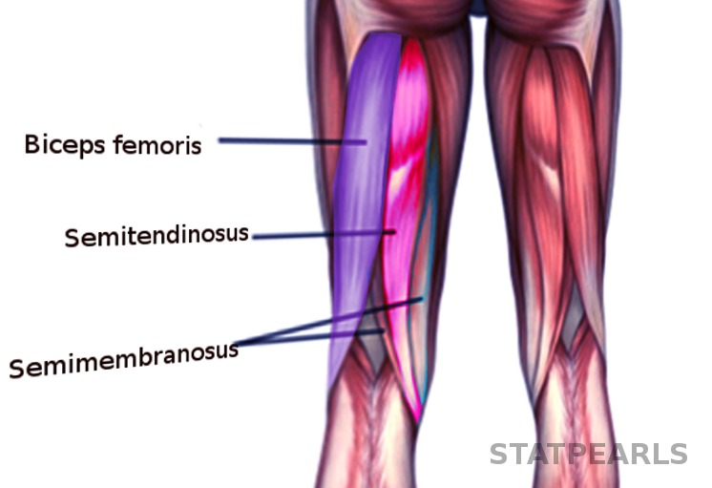
Posterior View
Notes:
12

Slide 13
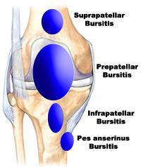
Other Structures
-Medial Meniscus:
- C-shaped fibrocartilage, cushions knee joint
-Lateral Meniscus:
- O-shaped fibrocartilage, cushions knee joint
-Iliotibial Tract (IT Band):
- Long tendinous band along the lateral thigh and knee
-Bursa Sacs:
- Fluid filled sacs that reduce friction
-4 located in the knee joint
-Suprapatellar
-Prepatellar
-Infrapatellar
-Pes Anserinus
-Patellar Tendon:
-Formed by quadriceps muscle group, anterior knee joint
inserts at Tibial Tuberosity

Slide 14
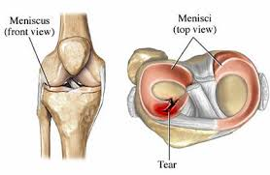
The Meniscus
Notes:
14

Slide 15
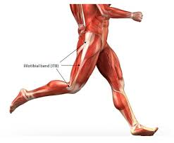
IT Band
Notes:
15

Slide 16
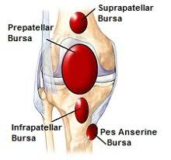
Bursa

Slide 17
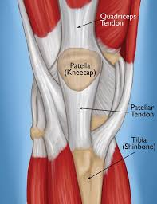
Patellar Tendon

